Slide 1
Station I. Creating Bonds
What is a chemical Bond?
Involves:
- Bond Breaking:
- Bond Making:
Sharing or transfer of valence electrons to achieve a full valence shell and to become STABLE
1. Stored energy (heat) in the bond
Absorb energy (add energy) → endothermic process
Release energy → exothermic process
2. Valence electrons trying to attain a noble gas configuration (8 valence electrons)

Slide 2
Station I. Creating Bonds
Example:
N + N → N₂ + energy
Energy is released when this bond forms making it an exothermic process.
Exothermic(creating bonds)
Checks for Understanding:
1. For the following chemical reaction is it an endothermic or exothermic process?
2Na(s) + Cl₂(g) →2NaCl(s)
2. Draw the Lewis structure for sulfur and identify how many bonding sites it has.
6 valence e-, 2 bonding sites

Slide 3
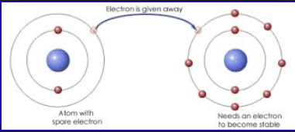
Station II. Ionic Bonding
Formed when:
Involves:
Properties:
ions bond together because of the oppositely charged ions attract each other
a metal transferring electrons to a nonmetal
1. High melting and boiling point
2. Solid (hard) at room temperature
3. Soluble (dissolve in water)
4. Conduct electricity in liquid and aqueous state

Slide 4
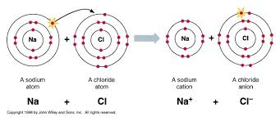
Station II. Ionic Bonds
Example:
Checks for Understanding:
1. Draw the Lewis dot diagram for NaCl.
Hint: First draw the ion form for Na and for Cl separately.
2. What type of elements make up ionic bonds?
Metal and a nonmetal

Slide 5
Station III. Covalent Bonding
Formed when:
Involves:
Forms:
Properties:
two atoms share electrons in order to achieve a STABLE arrangement of electrons
two nonmetals sharing electrons
molecules (molecular compounds)
1. Relatively low melting and boiling points
2. Exist as solid, liquid, or gas at STP
3. Soft
4. Will not conduct electricity in any phase
5. Sometimes soluble in water

Slide 6
Station III. Covalent Bonding
A. Polar Covalent Bonds:
Example: HBr
unequally sharing of electrons between two different nonmetals pulling on electrons unequally
Br has a greater electronegativity (3.0) than H (2.1), so it pulls on the electrons more. This makes the Br slightly negative pole and H slightly positive pole

Slide 7
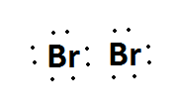
Station III. Covalent Bonding
B. Nonpolar Covalent Bonds:
Example: Br₂
Equal sharing of electrons between two identical nonmetals
The two Br have the same electronegativity, so they pull on the shared electrons evenly. Creating NO poles between them

Slide 8
Station III. Covalent Bonding
C. Multiple Covalent Bonds:
Double Bond:
Example: O₂
Triple Bond:
Example: N₂
sharing of two pairs of valence e⁻
sharing of three pairs of valence e⁻

Slide 9
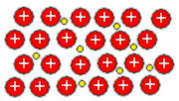
Station IV. Metallic Bonding
FEW
LOW
Metallic atoms have ________ valence electrons and ________ ionization energies
Results from:
Metallic bonding occurs when electrons given out from the metal atoms to make a “sea” of free electrons in between all the metal atoms.
the force of attraction of mobile electrons for an atom’s positively charged kernel (atom’s nucleus plus non-valence electrons)
Metallic Bonding

Slide 10
Station IV. Metallic Bonding
Properties:
Checks for understanding:
1. Which element has a crystalline lattice through which electrons flow freely?
A) Bromine B) Calcium C) Carbon D) Sulfur
2. Which element has properties of good electrical conductivity and luster and exists as a liquid?
A) Hg B) Br C) I C) C
1. Good conductors of electricity and heat
2. High melting and boiling points
3. Not soluble (can’t dissolve) in water

