Slide 1
Polarity and Hydrogen Bonding Post-Lab
water

Slide 2
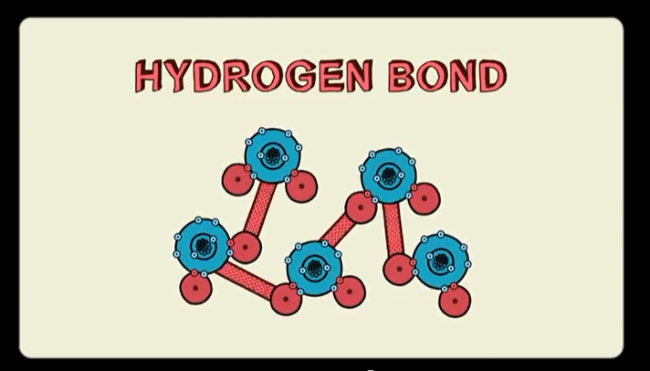
http://ed.ted.com/lessons/how-polarity-makes-water-behave-strangely-christina-kleinberg

Slide 3
Why does the water bend???
The comb picks up electrons giving it a negative charge.
The positive charges in the water are attracted to the negative charges from the comb, and the negative charges in the water are repelled.
Overall, the water has a net charge difference, so it bends toward the comb.

Slide 4
Water is a polar molecule--the O pulls the electrons more strongly, so it has a slightly more negative charge.
Oxygen is more electronegative than hydrogen.

Slide 5
Polar molecules have both:
1. Polar bonds (Determined by electronegativity)
2. Symmetry in all directions

Slide 6
Electronegativity: tendency of an atom to attract a bonding pair of electrons.
Electronegativity values are found in Table S of the reference table
More protons moving left to right = more “pull” on electrons
Fewer electron shells bottom to top = more “pull” on electrons

Slide 7
Examples:
CO → EN difference = 3.5 - 2.5 = 1.0
CO has a polar covalent bond because the EN difference is within the range 0.4 and 2.0.
Cl₂ → EN difference = 3.0 - 3.0 = 0
Cl₂ has a nonpolar covalent bond because the EN different is within the range 0.0 and 0.4.

Slide 8
Electronegativity difference between TWO atoms
gives us
Polarity of the bond
So now we need to know the
SYMMETRY
of the molecule to determine the
overall polarity of the molecule...

Slide 9
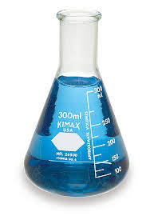
For some symmetry practice...
Are these shapes symmetrical or asymmetrical?
No symmetry
Symmetry

Slide 10
Now look at these molecules…
Are they symmetrical or asymmetrical?
No symmetry
Symmetry

Slide 11
No symmetry
Symmetry
Asymmetrical → POLAR
Symmetrical → NONPOLAR

Slide 12
SUMMARY: Polarity and Bond Type
Polar Covalent Molecules
*asymmetrical with polar bonds
*unequal distribution of electrons and charge
*dipole= positive & negative side
*EN difference between 0.4 and 2.0
Nonpolar Covalent Molecules
*symmetrical or nonpolar bonds
*equal distribution of electrons and charge
*EN difference between 0.0 and 0.4

Slide 13
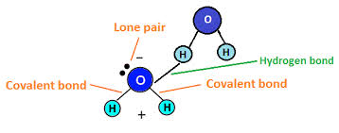
Hydrogen Bonding
Hydrogen Bond = a weak bond between two molecules resulting from an electrostatic attraction between a proton in one molecule and an electronegative atom in the other

Slide 14
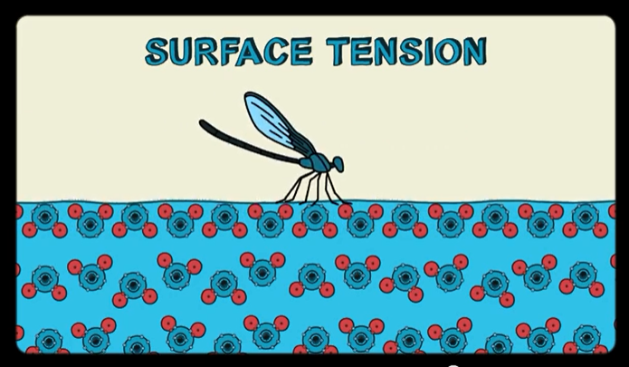
Hydrogen Bonding
So… why can a fly walk on water?
The water molecules are attracted to each other (cohesion) because water is asymmetrical and polar (unequal sharing of electrons), which causes hydrogen bonding between the water molecules.
So, if you are careful not to break these hydrogen bonds, an object can be held up by the water molecules due to surface tension. But hydrogen bonds are weak, so it cannot hold much weight or handle a lot of force.

