Slide 1
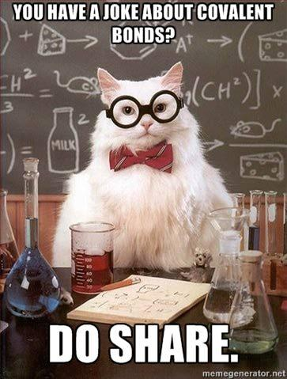
Bonding Review
Game
For the quiz tomorrow!
Notes:
Quiz question topics:
-Forming ionic compounds from ions in solution
-Differentiating between ionic and molecular compounds
-properties of ionic vs molecular compounds
-naming from name to formula and vice versa
-Lewis dot diagrams

Slide 2
Rules of the Game
Correct answers earn a certain amount of “money” and you can cash this “money” in for bonus points on the quiz.
Every $20 = 1 Bonus Point (Max of $88)
We will randomly draw names to assign teams.
Every question is timed. So each team must have their whiteboard in the air before the slide changes and makes a noise. There will be a 5 second warning noise before the slide changes.
Any team who gets the right answer within the time limit will receive “money”.

Slide 3
Rules of the Game
Team members who do not play the game will not be eligible for bonus points on the quiz.
Cheating will result in -$20 and this includes:
looking at other teams’ answers
going out of order
helping a teammate answer a question
looking up the answer
use of electronic devices

Slide 4
You have 1 minute to answer this first question.

Slide 5
Provide a chemical formula for all the ionic compounds you can make from the ions in solution below.
[+$2 per correct compound / -$2 per incorrect compound]
Fe⁺² Cl⁻ Fe⁺³
OH⁻ Mg⁺²

Slide 6
Provide a chemical formula for all the ionic compounds you can make from the ions in solution below.
[+$2 per correct compound / -$2 per incorrect compound]
Fe⁺², Fe⁺³, Mg⁺², Cl⁻, OH⁻
^{Answers:}
FeCl₂ MgCl₂
FeCl₃ Mg(OH)₂
Fe(OH)₂ Fe(OH)₃

Slide 7
You have 30 seconds to answer the following questions until further notice.

Slide 8
Which compounds in solution are molecular?
[+$2 per correct compound / -$2 per incorrect compound]
H₂0 KI CCl₄
H₂S CuCl₂
NiBr₃ HF HBr

Slide 9
Which compounds in solution are molecular?
[+$2 per correct compound / -$2 per incorrect compound]
Answer:
H₂0 KI CCl₄
H₂S CuCl₂
NiBr₃ HF HBr

Slide 10
Which is a property of most nonmetallic solids? [$3]
(1) high thermal conductivity
(2) high electrical conductivity
(3) brittleness
(4) malleability

Slide 11
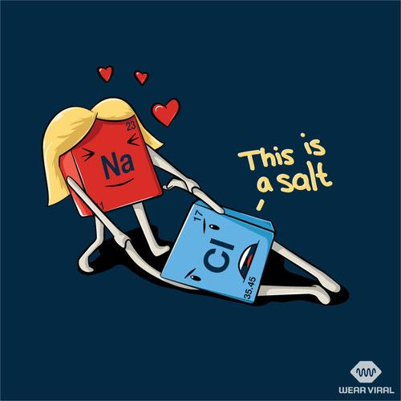
Which is a property of most nonmetallic solids? [$3]
Answer:
(1) high thermal conductivity
(2) high electrical conductivity
(3) brittleness
(4) malleability

Slide 12
Which substance can be decomposed by a chemical change? [$2]
(1) Co
(2) Cr
(3) CO
(4) Cu

Slide 13
Which substance can be decomposed by a chemical change? [$2]
Answer:
(1) Co
(2) Cr
(3) CO
(4) Cu

Slide 14
What is represented by the dots in a Lewis electron-dot diagram of an atom of an element in Period 2 of the Periodic Table? [$3]
(1) the number of neutrons in the atom
(2) the number of protons in the atom
(3) the number of valence electrons in the atom
(4) the total number of electrons in the atom

Slide 15
What is represented by the dots in a Lewis electron-dot diagram of an atom of an element in Period 2 of the Periodic Table? [$3]
Answer:
(1) the number of neutrons in the atom
(2) the number of protons in the atom
(3) the number of valence electrons in the atom
(4) the total number of electrons in the atom

Slide 16
Which type of chemical bond is formed between two atoms of bromine? [$2]
(1) metallic
(2) ionic
(3) hydrogen
(4) covalent

Slide 17
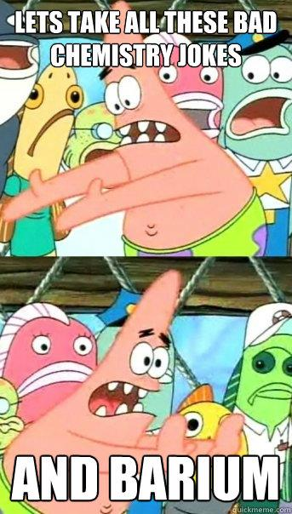
Which type of chemical bond is formed between two atoms of bromine? [$2]
Answer:
(1) metallic
(2) ionic
(3) hydrogen
(4) covalent

Slide 18
What is the chemical name for Cu₂O₃? [$3]

Slide 19
What is the chemical name for Cu₂O₃? [$3]
Answer:
copper (III) oxide
+$1 for correct elements
+$1 for correct Roman numeral
+$1 for -ide ending
-$1 for each extraneous thing added (charges, prefixes, Roman numerals, etc…)

Slide 20
Which element has atoms that can form single, double, and triple covalent bonds with other atoms of the same element? [$5]
(1) hydrogen
(2) oxygen
(3) fluorine
(4) carbon

Slide 21
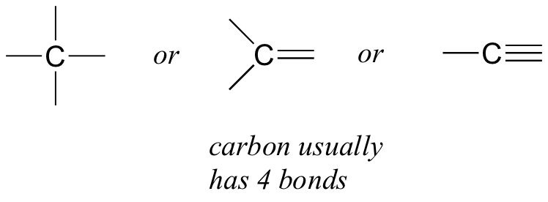
Which element has atoms that can form single, double, and triple covalent bonds with other atoms of the same element? [$5]
Answer:
(1) hydrogen
(2) oxygen
(3) fluorine
(4) carbon

Slide 22
Which type of bond is formed when electrons are transferred from one atom to another? [$2]
(1) covalent
(2) ionic
(3) hydrogen
(4) metallic

Slide 23
Which type of bond is formed when electrons are transferred from one atom to another? [$2]
Answer:
(1) covalent
(2) ionic
(3) hydrogen
(4) metallic

Slide 24
What is the chemical name for SiO₂? [$3]

Slide 25
What is the chemical name for SiO₂? [$3]
Answer:
silicon dioxide
+$1 for correct elements
+$1 for correct prefixes
+$1 for -ide ending
-$1 for each extraneous thing added (Roman numerals, etc…)

Slide 26
What is the chemical formula for
dinitrogen monoxide? [$2]

Slide 27
What is the chemical formula for dinitrogen monoxide? [$2]
Answer:
N₂O
+$1 for correct symbols
+$1 for correct subscripts
-$1 for each extraneous thing added (charges, superscripts, etc…)

Slide 28
The bonds in the compound MgSO₄ can be described as… [$5]
(1) ionic, only
(2) covalent, only
(3) both ionic and covalent
(4) neither ionic nor covalent

Slide 29
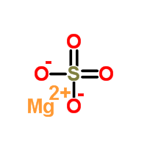
The bonds in the compound MgSO₄ can be described as… [$5]
Answer:
(1) ionic, only
(2) covalent, only
(3) both ionic and covalent
(4) neither ionic nor covalent

Slide 30
What is the chemical name for MnCl₇? [$3]

Slide 31
What is the chemical name for MnCl₇? [$3]
Answer:
manganese (VII) chloride
+$1 for correct elements
+$1 for correct Roman numerals
+$1 for -ide ending
-$1 for each extraneous thing added (charges, prefixes, etc…)

Slide 32
Which species can conduct an electric current? [$3]
(1) NaBr(s)
(2) CH₃OH(aq)
(3) H₂O(s)
(4) KCl(aq)

Slide 33
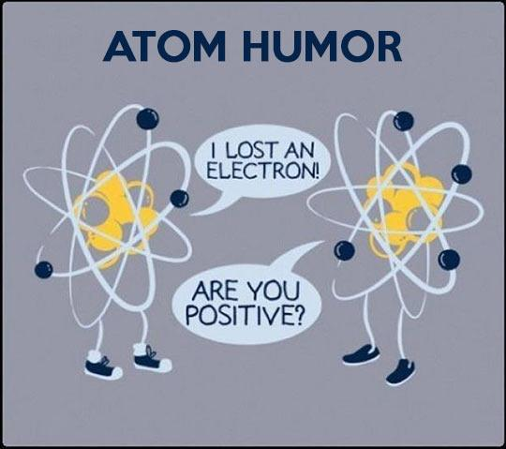
Which species can conduct an electric current? [$3]
Answer:
(1) NaBr(s)
(2) CH₃OH(aq)
(3) H₂O(s)
(4) KCl(aq)
IONIC compound dissolved in water

Slide 34
What is the chemical formula for silver hydroxide? [$2]

Slide 35
What is the chemical formula for silver hydroxide? [$2]
Answer:
AgOH
+$1 for correct symbols
+$1 for correct subscripts
-$1 for each extraneous thing added (charges, superscripts, parenthesis, etc…)

Slide 36
Which of the following solids has the highest melting point? [$2]
(1) H₂O(s)
(2) Na₂O(s)
(3) SO₂(s)
(4) CO₂(s)

Slide 37
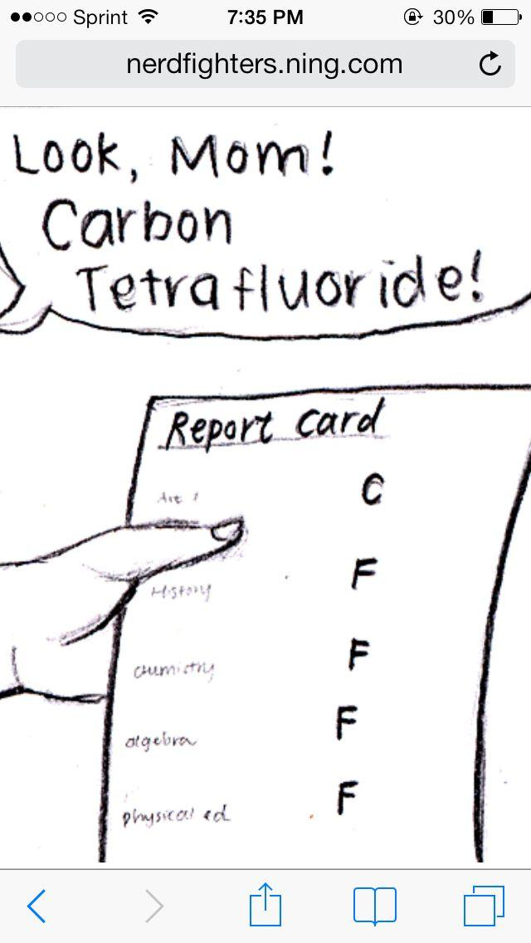
Which of the following solids has the highest melting point? [$2]
Answer:
(1) H₂O(s)
(2) Na₂O(s)
(3) SO₂(s)
(4) CO₂(s)
IONIC compound

Slide 38
You have 2 minutes to answer the following questions

Slide 39
Draw a Lewis dot diagram for SiO₂ [$5]

Slide 40
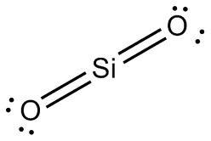
Draw a Lewis dot diagram for SiO₂ [$5]
Answer:
+$1 for Si as central atom
+$2 for correct number and
location of bonds
+$2 for correct number and
location of lone pairs
-$1 for each extraneous thing (brackets, charges, etc…)

Slide 41
Draw a Lewis dot diagram for H₂O [$3]

Slide 42
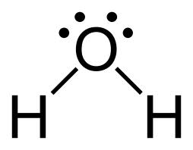
Draw a Lewis dot diagram for H₂O [$3]
Answer:
+$1 for O as central atom
+$1 for correct number and
location of bonds
+$1 for correct number and
location of lone pairs
-$1 for each extraneous thing (brackets, charges, etc…)

Slide 43
Draw a Lewis dot diagram for N₂ [$4]

Slide 44
Draw a Lewis dot diagram for N₂ [$4]
Answer:
+$2 for correct number and
location of bonds
+$2 for correct number and
location of lone pairs
-$1 for each extraneous thing (brackets, charges, etc…)

Slide 45
Draw a Lewis dot diagram for lead (II) chloride [$5]

Slide 46
Draw a Lewis dot diagram for the ionic compound
lead (II) chloride [$5]
Answer:
+$1 for correct symbols
+$1 for correct charges
+$1 for correct number of atoms
+$1 for correct brackets
+$1 for correct number and location of lone pairs

Slide 47
Draw the Lewis dot diagram for the ionic compound manganese (III) oxide [$5]

Slide 48
Draw the Lewis dot diagram for the ionic compound manganese (III) oxide [$5]
Answer:
+$1 for correct symbols
+$1 for correct charges
+$1 for correct number of atoms
+$1 for correct brackets
+$1 for correct number and location of lone pairs

Slide 49
Draw the Lewis dot diagram for the compound made from the ions Na⁺ and S²⁻ [$4]

Slide 50
Draw the Lewis dot diagram for the compound made from the ions Na⁺ and S²⁻ [$4]
Answer:
+$1 for correct charges
+$1 for correct number of atoms
+$1 for correct brackets
+$1 for correct number and location of lone pairs

Slide 51
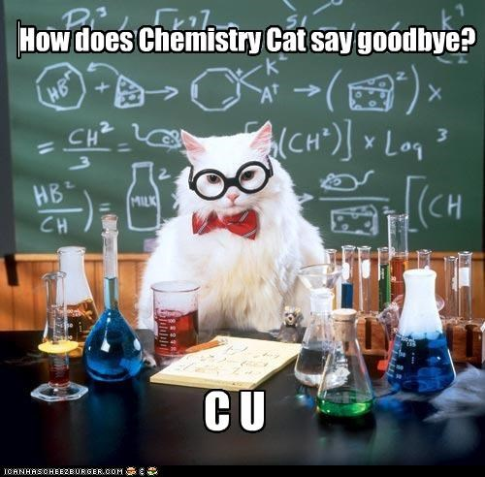
Good luck with your studies and see you tomorrow!

