Slide 1
Monday, January 6, 2014 2nd/3rd period
Bonding Review:
Ionic and Molecular Compounds

Slide 2
Monday, January 6, 2014 4th period
Bonding Review:
Ionic and Molecular Compounds

Slide 3
Ionic compounds | Molecular compounds (covalent bonds)
Stronger/Weaker attraction between ions/atoms to form ionic compounds | Stronger/Weaker attraction between ions/atoms to form molecular compounds
M
NM
NM
NM

Slide 4
Ionic compounds | Molecular compounds (_________ bonds)
Separate molecules/Formula units (such as NaCl) all bond together/separately. | Separate molecules/Formula units are formed with ionic/covalent bonds holding them together
M
NM
M
NM
NM
NM
M
NM
M
NM
NM
NM
M
NM
M
NM
NM
NM
NM
NM

Slide 5
Ionic compounds | Molecular compounds (__________ bonds)
Lower/Higher melting and boiling points | Lower/Higher melting and boiling points
Requires less/more energy (higher/lower temp) to melt or boil | Requires less/more energy (higher/lower temp) to melt or boil
_______→ liquid → _______
increasing movement
M
NM
M
NM
NM
NM
NM
NM
M
NM
M
NM
NM
NM
M
NM
M
NM
NM
NM

Slide 6
Ionic compounds | Molecular compounds (_________ bonds)
Ionic compounds conduct __________ when dissolved in water or molten because _____ (charged particles) are free to move | Do not conduct __________ as solids, dissolved particles, or in molten state (no ions to move) Molecular solids are hard/soft.

Slide 7
1. As a bond between a hydrogen atom and a sulfur atom is formed, electrons are
(1) shared to form an ionic bond
(2) shared to form a covalent bond
(3) transferred to form an ionic bond
(4) transferred to form a covalent bond

Slide 8
1. As a bond between a hydrogen atom and a sulfur atom is formed, electrons are
(1) shared to form an ionic bond
(2) shared to form a covalent bond
(3) transferred to form an ionic bond
(4) transferred to form a covalent bond

Slide 9
2. Which statement describes the composition of potassium chlorate, KClO₃?
(1) The proportion by mass of elements
combined in potassium chlorate is fixed.
(2) The proportion by mass of elements
combined in potassium chlorate varies.
(3) Potassium chlorate is composed of four
elements.
(4) Potassium chlorate is composed of five
elements.

Slide 10
2. Which statement describes the composition of potassium chlorate, KClO₃?
(1) The proportion by mass of elements
combined in potassium chlorate is fixed.
(2) The proportion by mass of elements
combined in potassium chlorate varies.
(3) Potassium chlorate is composed of four
elements.
(4) Potassium chlorate is composed of five
elements.

Slide 11
3. Which characteristic is a property of molecular
substances?
(1) good heat conductivity
(2) good electrical conductivity
(3) low melting point
(4) high melting point

Slide 12
3. Which characteristic is a property of molecular
substances?
(1) good heat conductivity
(2) good electrical conductivity
(3) low melting point
(4) high melting point

Slide 13
4. Which compound does not dissolve in water to form an aqueous solution that can conduct an electric current?
(1) NaOH
(2) Ba(OH)₂
(3) Ca(OH)₂
(4) CH₃OH

Slide 14
4. Which compound does not dissolve in water to form an aqueous solution that can conduct an electric current?
(1) NaOH
(2) Ba(OH)₂
(3) Ca(OH)₂
(4) CH₃OH

Slide 15
5. Which compound contains both ionic and
covalent bonds?
(1) ammonia
(2) methane
(3) sodium nitrate
(4) potassium chloride

Slide 16
5. Which compound contains both ionic and
covalent bonds?
(1) ammonia
(2) methane
(3) sodium nitrate
(4) potassium chloride

Slide 17
Polar molecules have both:
Polar molecules are ionic/molecular compounds with bonds between atoms
1. _______ bonds (Determined by electronegativity)
2. Overall symmetry/asymmetry

Slide 18
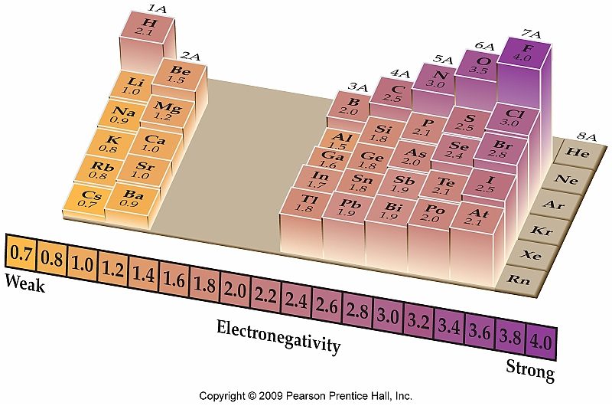
: tendency of an atom to attract a bonding pair of electrons.
Electronegativity values are found in of the reference table
More protons moving to _____= more “pull” on electrons
Fewer electron shells _____ to _____= more “pull” on electrons

Slide 19
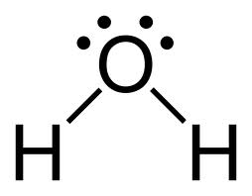
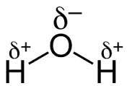
SUMMARY: Polarity and Bond Type
Polar Covalent Molecules
asymmetrical with polar bonds
equal/unequal distribution of electrons and charge
dipole = __________________
EN difference between ___ and ____
Nonpolar Covalent Molecules
symmetrical or nonpolar bonds
equal/unequal distribution of electrons and charge
EN difference between ___ and ____

Slide 20
6. Which element has an atom with the greatest
attraction for electrons in a chemical bond?
(1) As
(2) Bi
(3) N
(4) P

Slide 21
6. Which element has an atom with the greatest
attraction for electrons in a chemical bond?
(1) As
(2) Bi
(3) N
(4) P

Slide 22
7. Which formula represents a polar molecule?
(1) Br₂
(2) CO₂
(3) CH₄
(4) NH₃
(Hint: drawing Lewis dot diagrams will help you answer this question)

Slide 23
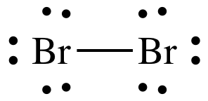
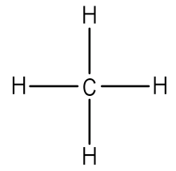
7. Which formula represents a polar molecule?
(1) Br₂
(2) CO₂
(3) CH₄
(4) NH₃

Slide 24
8. Draw a Lewis dot diagram for
tin (IV) oxide

Slide 25
8. Draw a Lewis dot diagram for
tin (IV) oxide
2 Sn⁺⁴ 4

Slide 26
9. Draw a Lewis dot diagram for C₂H₂

Slide 27
9. Draw a Lewis dot diagram for C₂H₂

Slide 28
Ionic Bonding: Writing Chemical formulas
Criss Cross Method: ions to chemical formula
1. Write symbols and charges of ions.
2. Crisscross: The anion/cation (+) charge becomes the anion subscript
The anion/cation (-) charge becomes the cation subscript
3. Final format for ionic formulas
-Do/Don’t write ionic charges
-reduce ________ to lowest ratio
-do NOT write the subscript “__”
-For polyatomic ions, parenthesis may be needed to separate two different subscripts.
Example:
Mg⁺⁴, O⁻² → Mg₂O₄ → MgO₂
ions criss crossed reduced form

Slide 29
Ionic Bonding: Writing Chemical formulas
Reverse Criss Cross: chemical formula to ions
1. Reverse criss cross the chemical formula’s subscripts to determine each elements charge.
2. Break up the formula into its ions. Be sure to write in the charges used.
+ for the metal/nonmetal (1st element)
- for the metal/nonmetal (2nd element)
3. Double check these charges with the periodic table because the charges from reverse criss crossing may not exist for those elements due to the chemical formulas being __________.
Example:
FeP → Fe⁺¹, P⁻¹ ? → Fe⁺³, P⁻³
chemical formula reverse criss crossed checked periodic table for accurate charges

Slide 30
Rules for Naming Ionic Compounds
Metals keep their name.
When the metals have more than one _________ number (charge in the right hand corner of the periodic table), you must make note of this in the name using a ______ _______ (I, II, III, ___, ___, ___, etc).
Example: Mn⁺² --> Mn (II)
Mn^{+__} --> Mn (IV)
Non-metals keep the first syllable and change the ending to –____.
Example: _______ --> Oxide
Polyatomic ions can be found in Table __ and always keep their names. PAI’s with positive/negative charges act as the metal and PAI’s with positive/negative charges act as the nonmetal.

Slide 31
Naming Ionic Compounds
# | IONS | CHEMICAL FORMULA | CHEMICAL NAME
10. |  |  | Barium Iodide
11. |  | Mn₂O₇
12. |  |  | Cobalt (III) phosphide
13. | NH₄⁺, S⁻²

Slide 32
Naming Ionic Compounds
# | IONS | CHEMICAL FORMULA | CHEMICAL NAME
10. | Ba⁺², I⁻ | BaI₂ | Barium Iodide
11. | Mn⁺⁷, O⁻² | Mn₂O₇ | Manganese (VII) Oxide
12. | Co⁺³, P⁻³ | CoP | Cobalt (III) phosphide
13. | NH₄⁺, S⁻² | (NH₄)₂S | Ammonium sulfide

Slide 33
Rules for Naming Molecular Compounds
Name the elements in the order they are listed in the chemical formula.
For how many atoms that each molecule has, add the prefix of that element. (example: _____=1, ____=2, _____=3, _____=4, _____=5, _____=6, ____=7, _____=8, _____=9, _____=10)
First nonmetal with only one atom does not have “_____-” in name.
First/Second nonmetal keeps its name and needs prefix if it has more than one atom.
Second nonmetal always/sometimes/never has a prefix.
Second nonmetal ends in –____.

Slide 34
Naming Molecular Compounds
# | CHEMICAL FORMULA | CHEMICAL NAME | POLAR OR NONPOLAR MOLECULE?
14. |  | dinitrogen tetrahydride
15. | CBr₄
16. |  | sulfur hexachloride
17. | SiO₂
Notes:
do

Slide 35
Naming Molecular Compounds
# | CHEMICAL FORMULA | CHEMICAL NAME | POLAR OR NONPOLAR MOLECULE?
14. | N₂H₄ | dinitrogen tetrahydride | polar
15. | CBr₄ | carbon tetrabromide | nonpolar
16. | SCl₆ | sulfur hexachloride | nonpolar
17. | SiO₂ | silicon dioxide | nonpolar
Notes:
do

