Slide 1
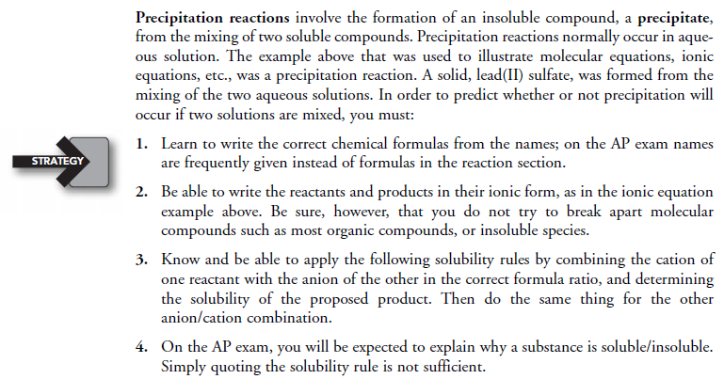
1a. Precipitation Reactions

Slide 2
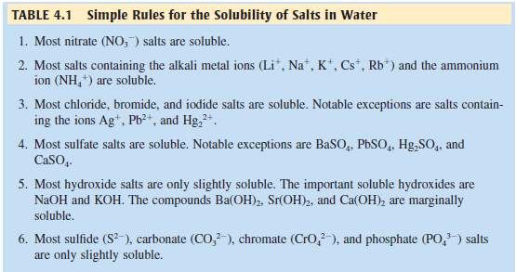
1b. Precipitation Reactions

Slide 3
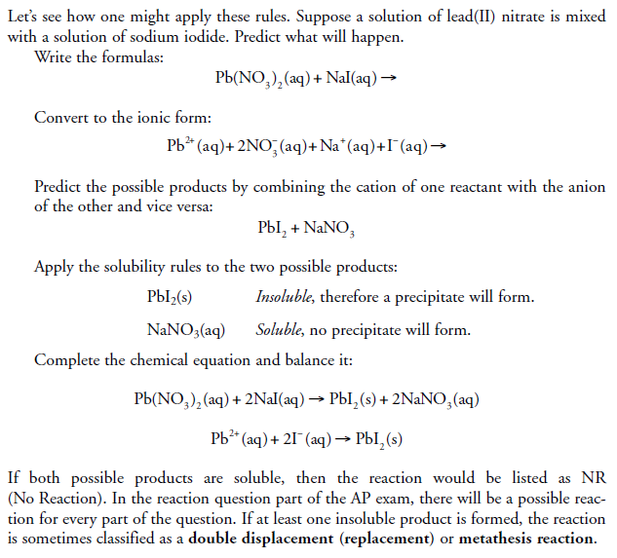
1c. Precipitation Reactions
Example 1

Slide 4
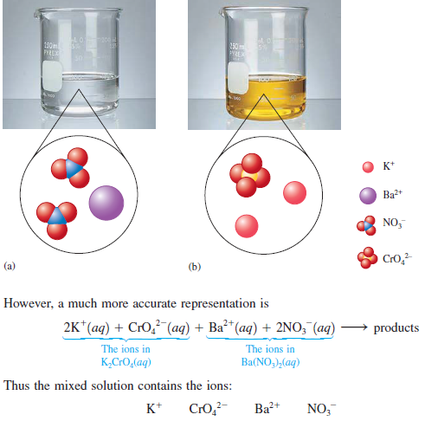
1d. Precipitation Reactions
Example 2a

Slide 5
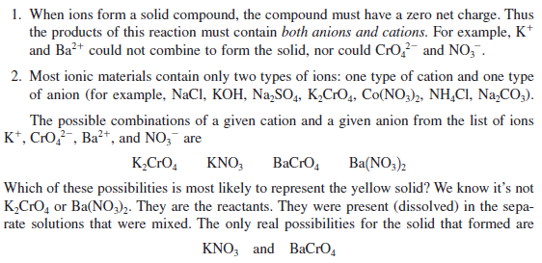
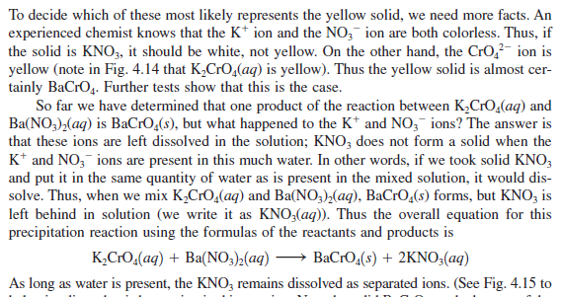
1e. Precipitation Reactions
Example 2b

Slide 6
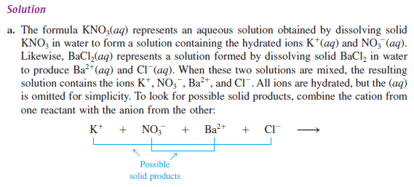
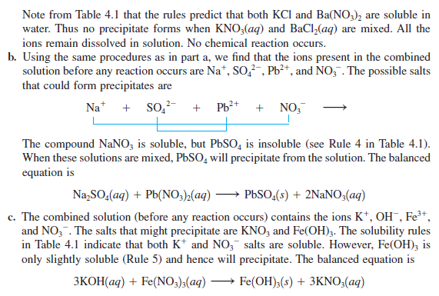
1f. Precipitation Reactions
CHECK FOR UNDERSTANDING
ANSWER

Slide 7
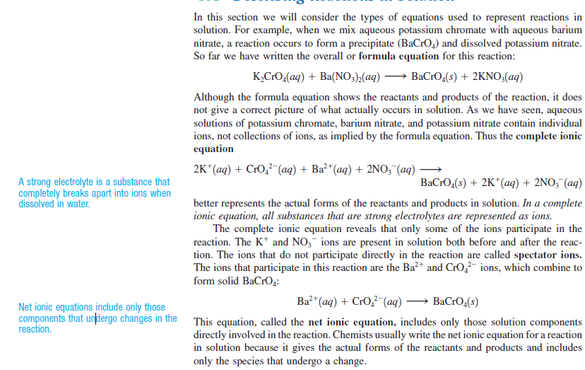
2a. Describing reactions in solutions

Slide 8
2b. Describing reactions in solutions

Slide 9
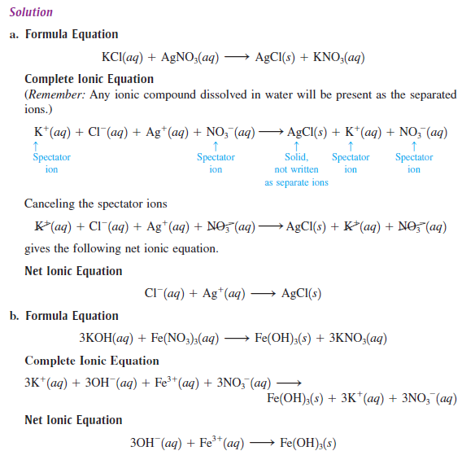
2c. Describing reactions in solutions
CHECK FOR UNDERSTANDING
ANSWER

Slide 10
3a. acid/base reactions

Slide 11
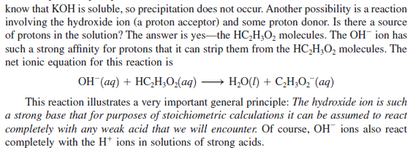
3b. acid/base reactions

Slide 12
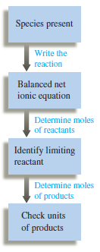
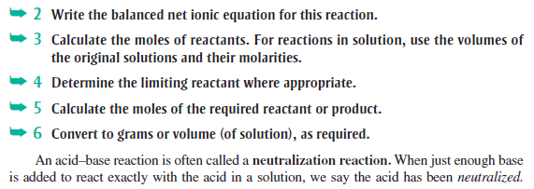
3c. acid/base reactions
Performing calculations for acid-base reactions

Slide 13
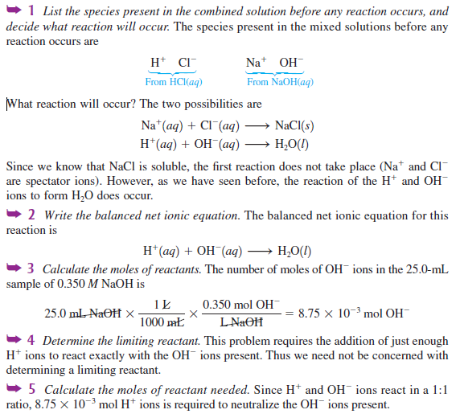
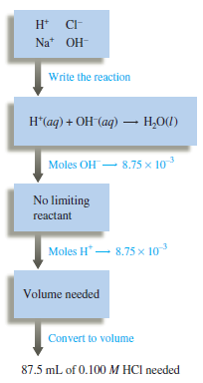
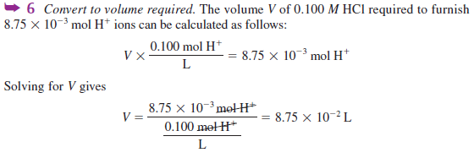
CHECK FOR UNDERSTANDING
ANSWER

Slide 14
4a. Redox reactions

Slide 15
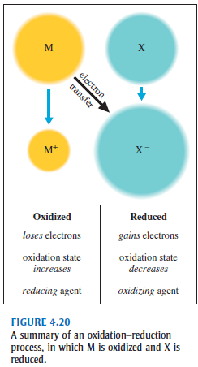
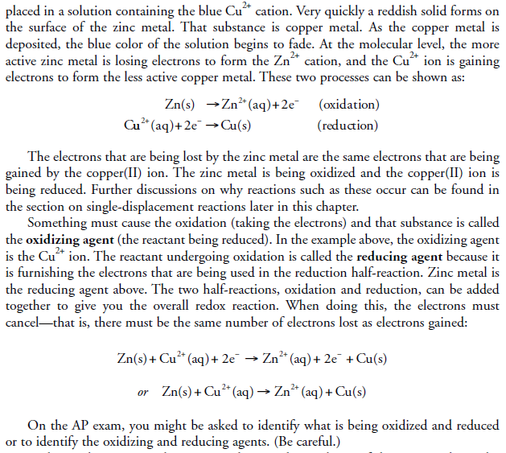

Slide 16
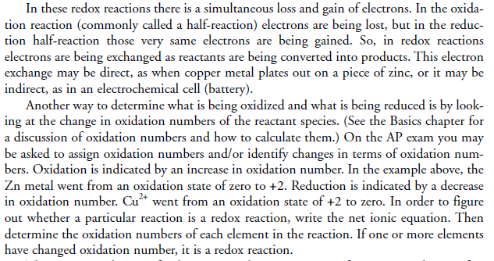
4c. Redox reactions

Slide 17
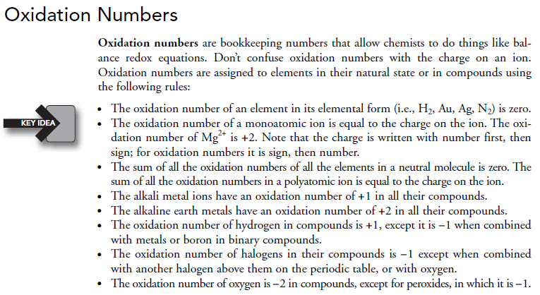
4d. Redox reactions

Slide 18
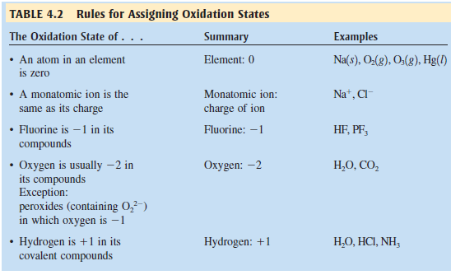
4e. Redox reactions

Slide 19
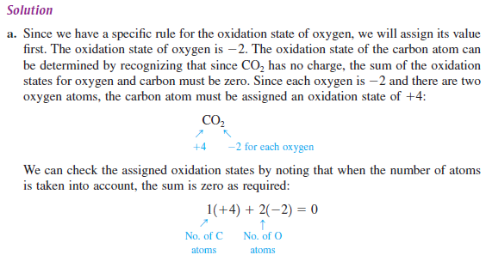
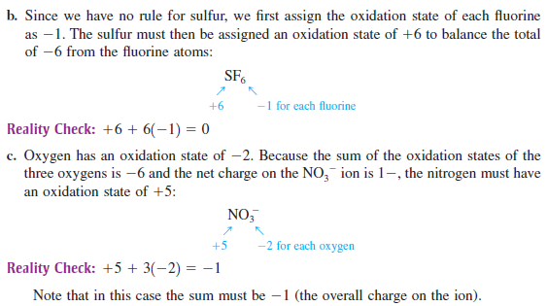
4. Redox reactions
CHECK FOR UNDERSTANDING
ANSWER

