Slide 1
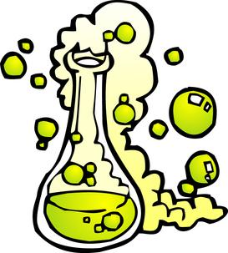
Types of Reactions

Slide 2
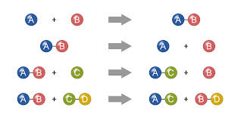
Label the following reaction types as either… Synthesis, Single Replacement, Double Replacement, OR Decomposition

Slide 3
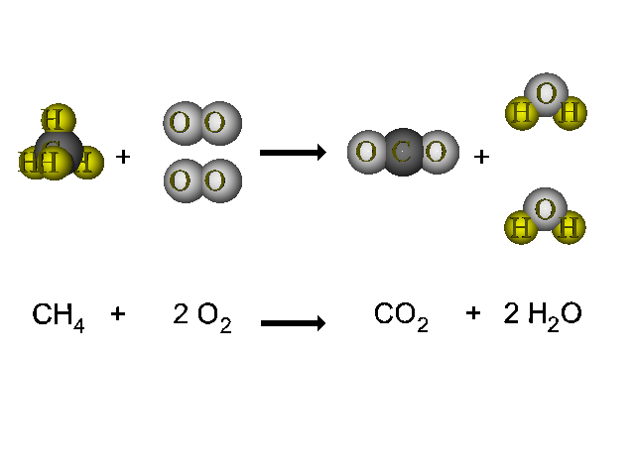
Combustion Reaction: A reaction with oxygen that releases energy and always produces carbon dioxide and water
Example of particle diagrams
Common Mistake!!! Do NOT confuse these reactions with replacement reactions.

Slide 4
Identify the following reactions as… Synthesis, Decomposition, Single Replacement, Double Replacement, OR Combustion

Slide 5
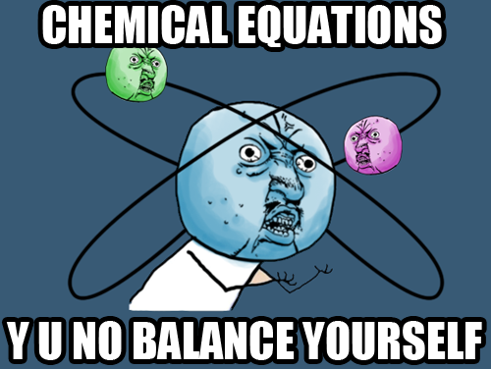
Conservation of Mass: Balancing Equations

Slide 6
Law of Conservation of Matter
In a chemical reaction, matter can be neither created nor destroyed.
In a chemical reaction, the amount of reactants equal the amount of products.

Slide 7
Law of Conservation of Matter
Law of Conservation of Atoms:
The number of atoms of each type of element must be the same on each side of the equation.

Slide 8
What happens when a given equation does not conserve mass?
# atoms for reactants ≠ # atoms of products
Mass is NOT conserved
Must balance the equation by adding coefficients to the elements/compounds in the reaction.

Slide 9
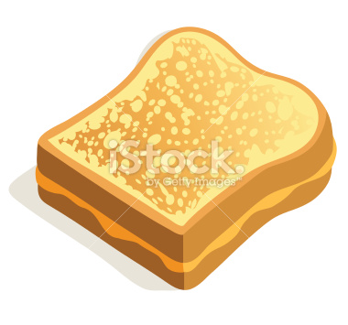
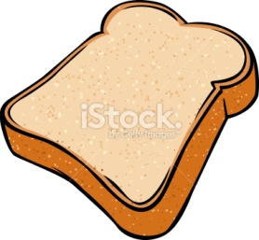
How do we balance equations?
For example: Think about a grilled cheese sandwich…
2
6

Slide 10
How do we balance equations?
Example | Steps
__ Zn + _ HCl → __ H₂ + __ ZnCl₂ | 1. Draw a T chart under the equation. Label the left side reactants and the right side products. Write the symbol and number of atoms for each element present in the reaction on its own line on both sides.
No, mass is not conserved as the equation is written. | 2. Does each element start and end with the same number of atoms? Yes → Mass is conserved and the equation is balanced No → Mass is not conserved and you need to balance the equation. (move on to step 3)

Slide 11
Example | Steps
__ Zn + 2 HCl → __ H₂ + __ ZnCl₂ | 3. If mass is not conserved, you will balance the equation by adding coefficients before molecules. *Do not change any subscripts.* Start with an element that only appears once on each side. On the side that has fewer atoms of that element, add a coefficient before the molecule containing that element, so that the number of atoms of that element on both sides are equal. In the T chart, multiply the coefficient by the subscript on each element in the molecule to get the new numbers of atoms.

Slide 12
Example | Steps
Final answer: Zn + 2 HCl → H₂ + ZnCl₂ Mass is now conserved so the equation is balanced properly. | 4. Again, does each element start and end with the same number of atoms? Yes → Mass is conserved and the equation is balanced No → Mass is not conserved and you need to change another coefficient. Repeat step 3

