Slide 1
Intermolecular Forces

Slide 2
Relative Magnitudes of Forces

Slide 3
Hydrogen Bonding

Slide 4
Hydrogen Bonding in DNA

Slide 5
Hydrogen Bonding in DNA

Slide 6
Dipole Related Forces

Slide 7
London Dispersion Forces

Slide 8
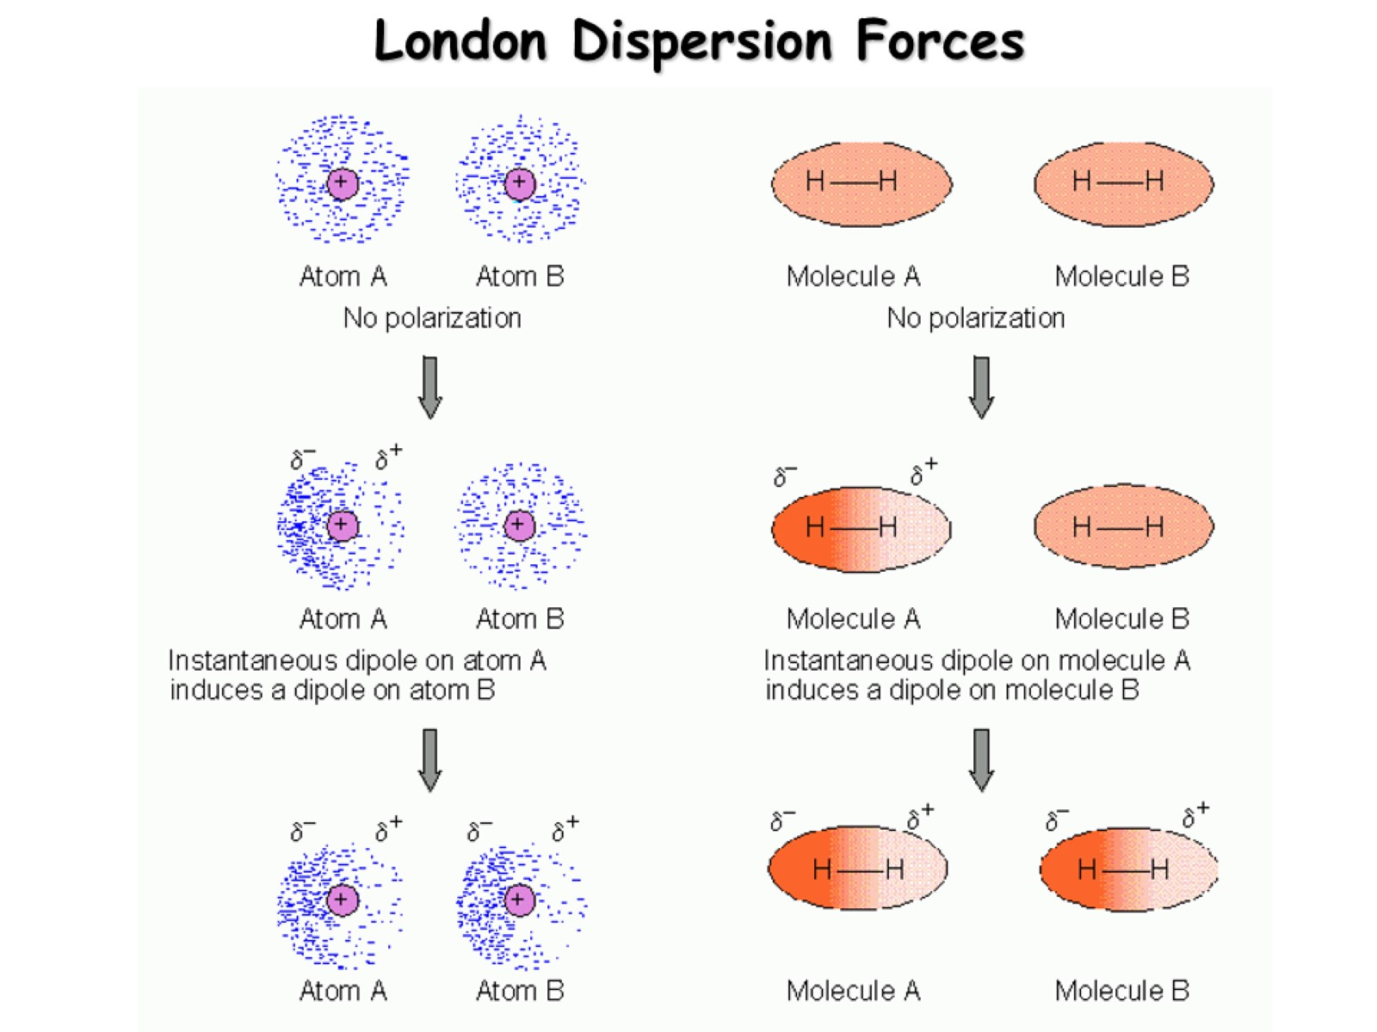
London Dispersion Forces

Slide 9
London Forces in Hydrocarbons

Slide 10
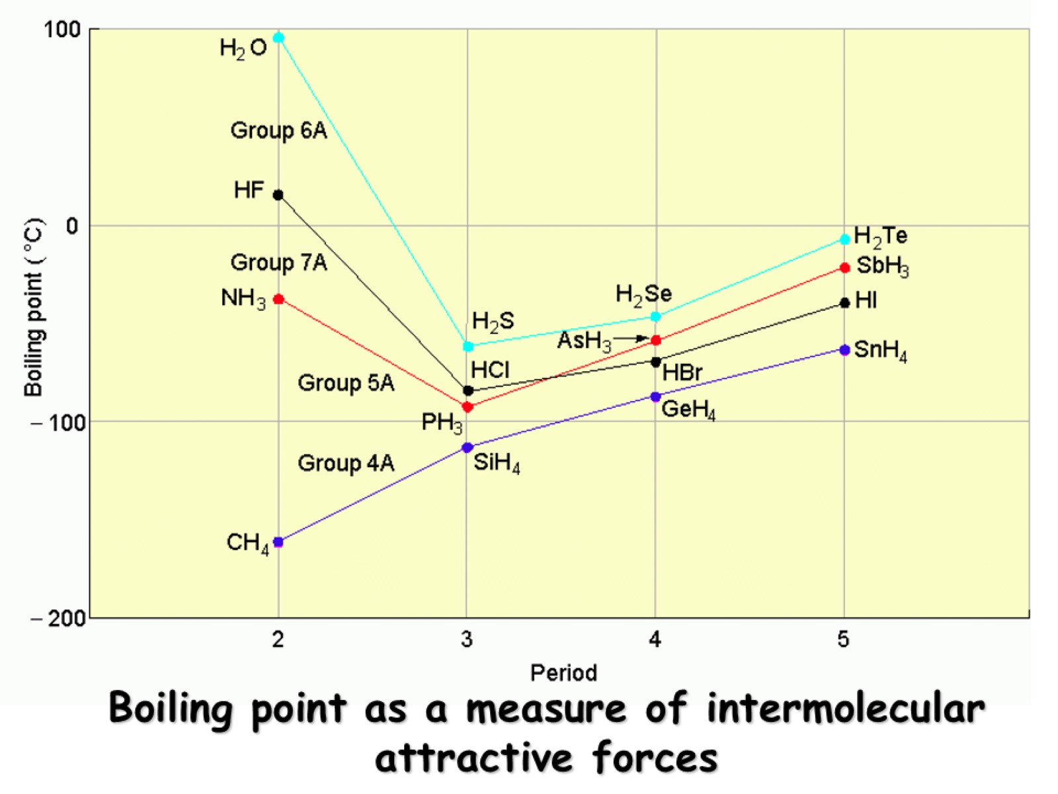
Boiling point as a measure of intermolecular attractive forces

