Slide 1
Properties of Liquids

Slide 2
Surface Tension

Slide 3
Capillary Action

Slide 5
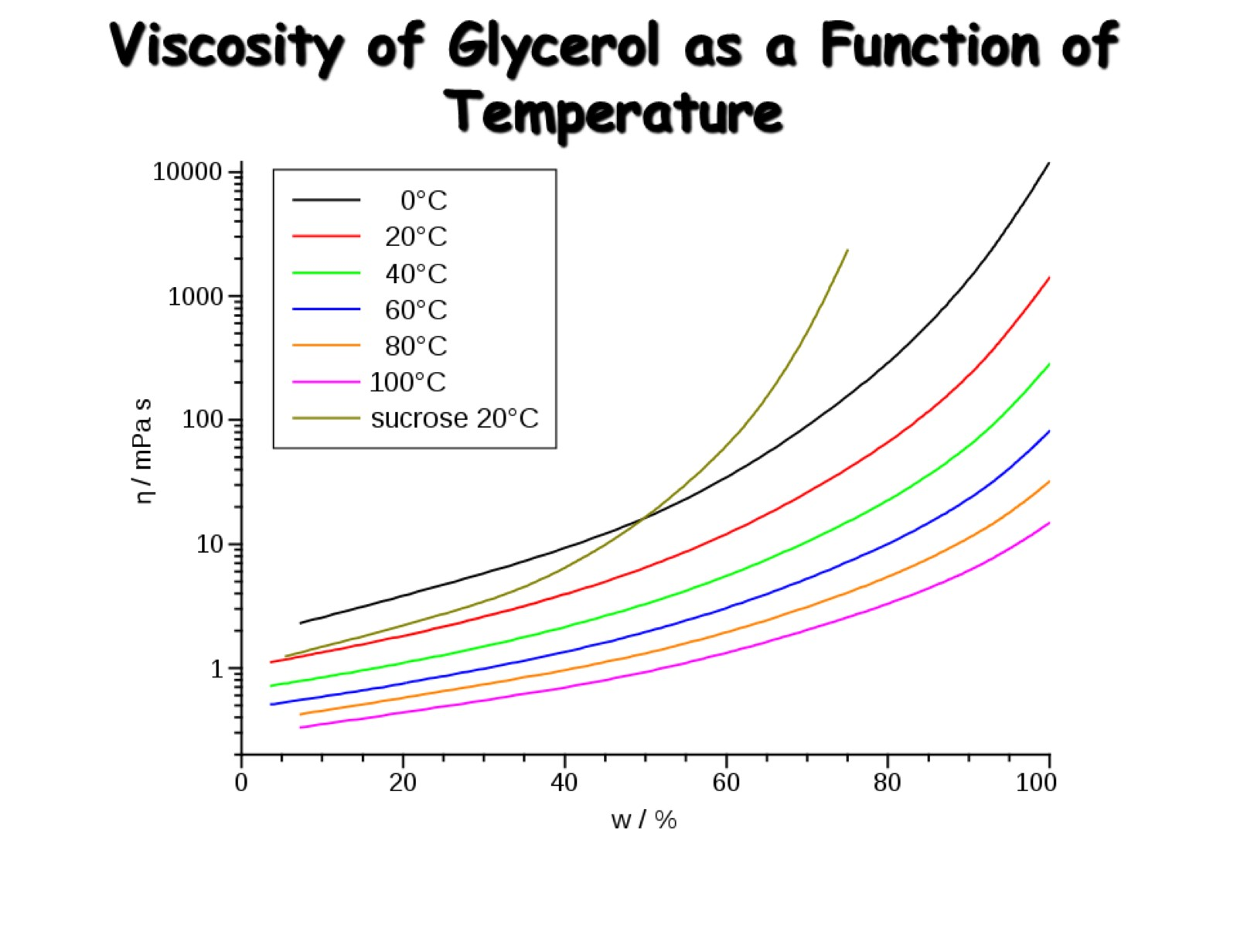
Viscosity of Glycerol as a Function of Temperature

