Slide 1
Solids

Slide 2
Types of Solids

Slide 3
Representation of Components in a Crystalline Solid

Slide 4
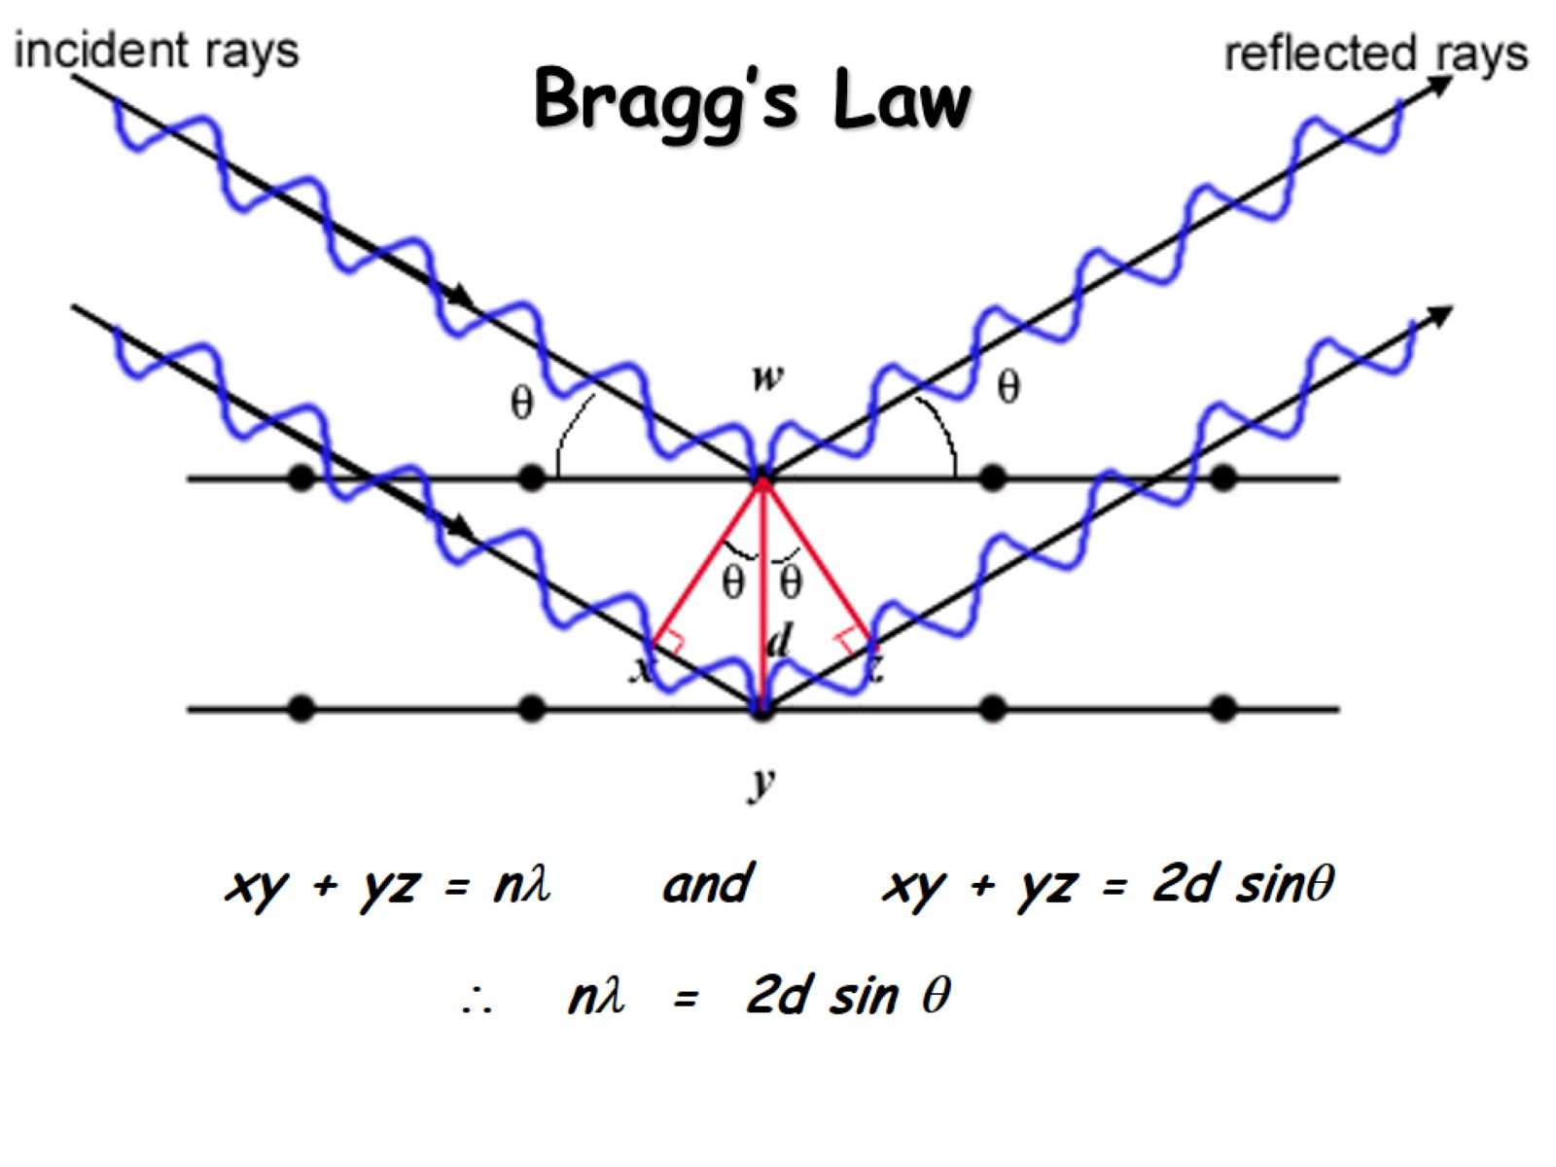
Bragg’s Law

Slide 5
Crystal Structures - Cubic

Slide 6
Crystal Structures - Monoclinic

Slide 7
Crystal Structures - Tetragonal

Slide 8
Crystal Structures - Orthorhombic

Slide 9
Crystal Structures – Other Shapes

Slide 10
Closest Packing: Single Layer

Slide 11
Closest Packing: Multiple Layers

Slide 12
Metal Alloys

Slide 13
Metal Alloys (continued)

Slide 14
Network Atomic Solids

Slide 15
Graphene

Slide 16
Semiconductors

Slide 17
n-type Semiconductors

Slide 18
p-type Semiconductors

Slide 19
Molecular Solids

Slide 20
Ionic Solids

Slide 21
Ionic Solids

