Slide 1
Solution Formation

Slide 2
Heat of Solution

Slide 3
Steps in Solution Formation

Slide 4
Steps in Solution Formation

Slide 5
Steps in Solution Formation

Slide 6
Predicting Solution Formation

Slide 7
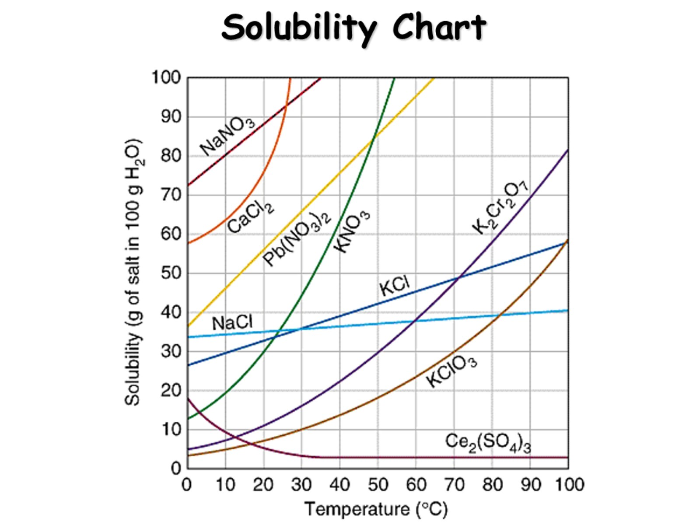
Solubility Chart

