Slide 1
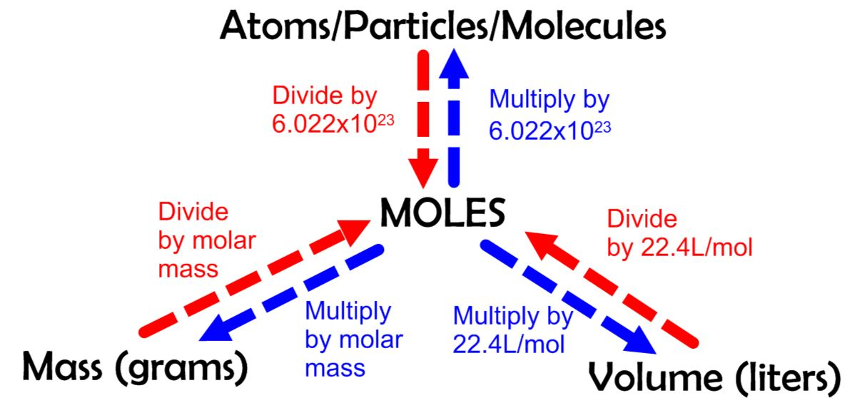
Mass, Moles, Molecules

Slide 2
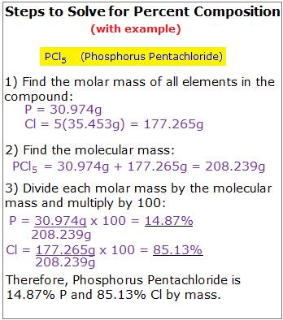
Percent Composition

Slide 3
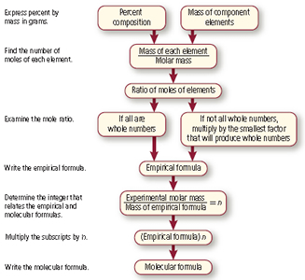
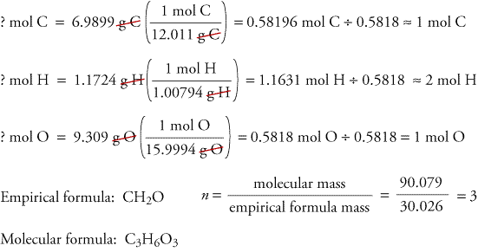
Empirical and Molecular Formulas

Slide 4
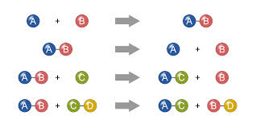
Reaction Types

Slide 5
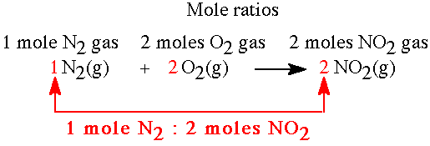
Mole Ratios
Example:
If you have 9 moles of N₂, how many moles of NO₂ will form?
1 mol N₂ = 9 mol of N₂
2 mol NO₂ x mol of NO₂
(1 mol N₂)(x mol of NO₂) = (9 mol of N₂)(2 mol NO₂)
X = 18 mol NO₂
STEPS
Determine the mole ratio of the particles involved.
Set up a proportion.
Cross multiply.
Solve for x.

