Slide 1
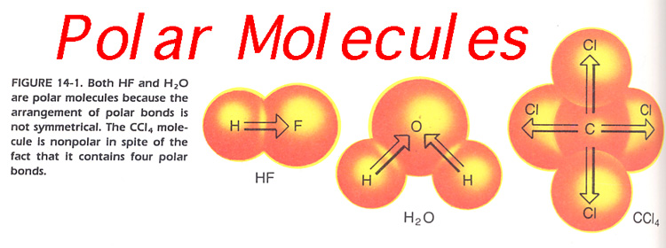
I. Polar vs Nonpolar
Polarity – a separation of electric charge leading to a molecule or its chemical groups having an electric dipole (a positive and negative end).
Polar molecule–
An asymmetrical molecule with an unequal distribution (spread) of electrons throughout.
NonPolar molecule–
A symmetrical molecule with electrons equally spread out throughout the molecule.

Slide 2
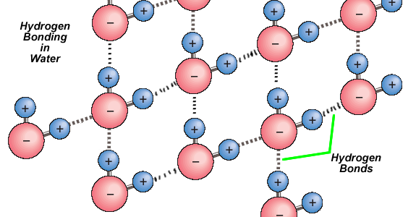
II. Intermolecular Forces and Rates of Solution
Intermolecular Force -- Forces of attraction or repulsion which act between neighboring particles (atoms, molecules or ions). They are weak compared to the intramolecular forces, the forces which keep a molecule together.
Inter- means between
Intra- means within
Hydrogen Bonding – a weak bond between two molecules resulting from the force between the positive hydrogen end of one molecule and the negative oxygen end of another molecule

Slide 3
II. Intermolecular Forces and Rates of Solution
increase
increase
1. Size of particles: (_______ surface area, ________ rate of solution)
2. Stirring – more surface area brought into contact
3. Amount already dissolved: (_______ dissolved, ________ rate)
4. Temperature:
Solids and Liquids: _________ temperature, _______ rate
- Gases: __________ temperature, ___________ rate
-
more
slower
increase
increase
increase
decrease

Slide 4
III. What is a solution?
What type of bonding is going on in NaCl?
What type of compound is NaCl?
What type of bonding is going on in H₂O?
What type of compound is going on in H₂O?
What type of molecule is H₂O?
When NaCl is added to H2O, what happens to the Na⁺ and Cl⁻ ions with respect to the H₂O molecules?
ionic
ionic
Polar covalent
molecular
polar
Positive Na ions are attracted to the negative pole (O) in the water molecule
Negative Cl ions are attracted to the positive pole (H’s) in the water molecule

Slide 5
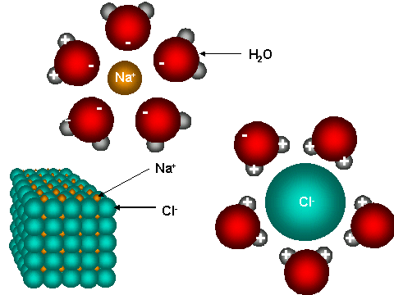
III. What is a solution?
Dissolving and Dissociation: Salt (NaCl) and Water
NaCl (s) → Na⁺ (aq) + Cl⁻ (aq)
Dissolving occurs when the solvent is ______________________
Dissociation is when ____________ compounds or ions get pulled apart by the ________________ end of the____________:
POLAR
IONIC
+ and -
polar solvent

Slide 6
III. What is a solution?
Types of Solutions:
- Gas with gas:
Liquid with liquid:
Gas with Liquid:
Solid with liquid:
Sold with Solid:
Atmosphere (O₂, N₂, CO₂)
Antifreeze
Soda (CO₂ (g) in H₂O (l))
Salt water (NaCl (s) in H₂O (l))
Alloys: Mixture of metals (brass – copper and zinc)

Slide 7
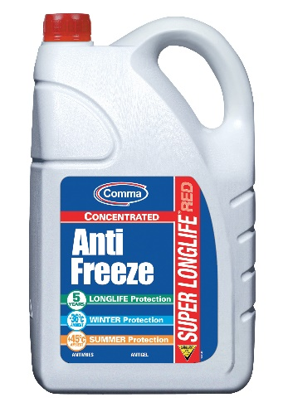
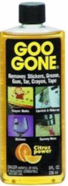
IV. Solubility Factors
Solubility: Amount of solute that will dissolve in solvent
Soluble: solute will dissolve and form a solution
Insoluble: substance does not dissolve to form a solution
Nature of Solute and Solvent:
-
“likes dissolves likes”: Polar solvent dissolves a polar solute, Nonpolar solvent dissolves a nonpolar solute
Solution Type | Nonpolar Solvent | Polar Solvent
Nonpolar
Polar
Ionic
Soluble
insoluble
insoluble
soluble
insoluble
soluble

Slide 8
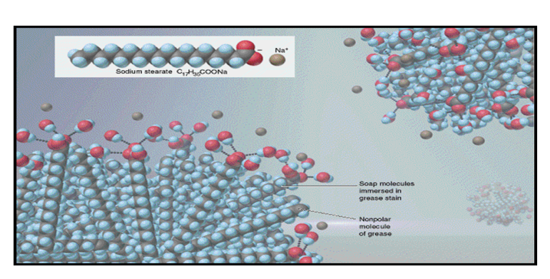
IV. Solubility Factors

Slide 9
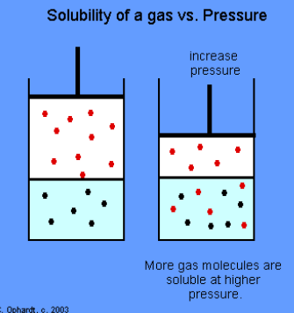
IV. Solubility Factors
2. Temperature:
Solids: ________ temperature, _________ solubility (more solid will dissolve)
Gases: ________ temperature, _________ solubility
3. Pressure:
Only effects gases in liquids
Gases: ________ pressure, ___________ solubility
-
increase
increase
increase
decrease
increase
increase

