Slide 1
KINETICS AND EQUILIBRIUM TEAM JEOPARDY

Slide 2
Directions
Any team who gets the right answer will get a point. 2 points per question.
Bonus 1 point for getting the answer correct first.
You must take turns answering questions.
For every 5 points you get in this game, you will receive 1 BONUS POINT on your test.
Points taken away for cheating.

Slide 3
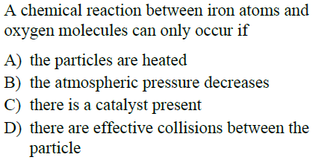
Question 1

Slide 4
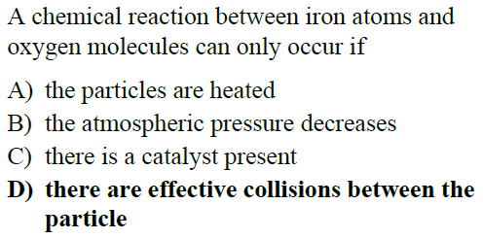
Answer 1

Slide 5
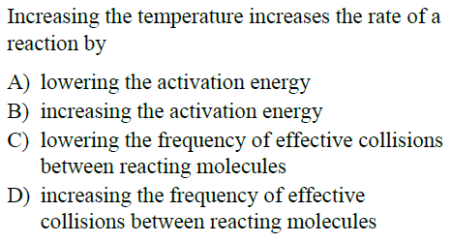
Question 2

Slide 6
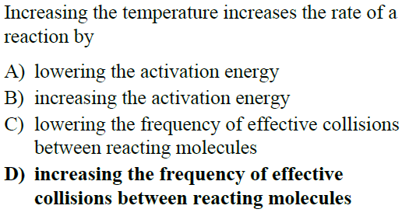
Answer 2

Slide 7
Question 3

Slide 8
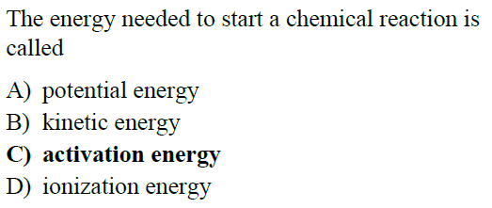
Answer 3

Slide 9
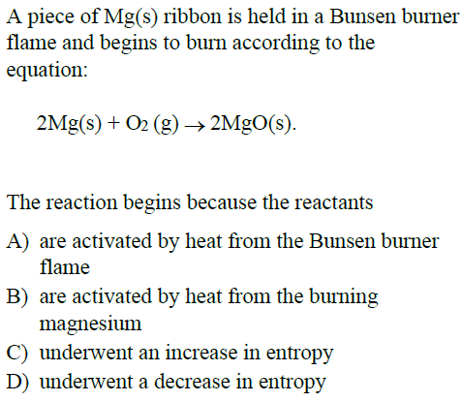
Question 4

Slide 10
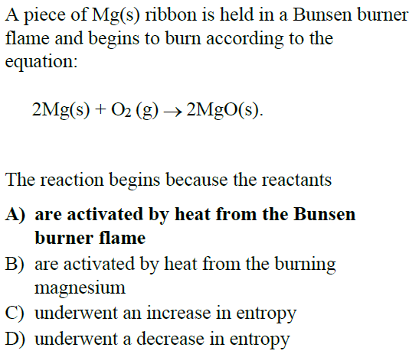
Answer 4

Slide 11
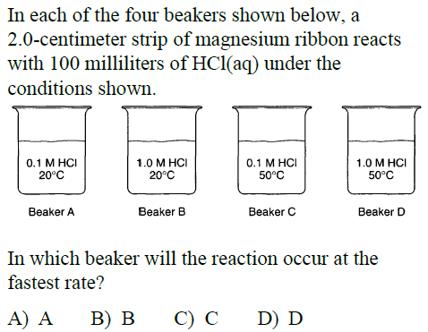
Question 5

Slide 12
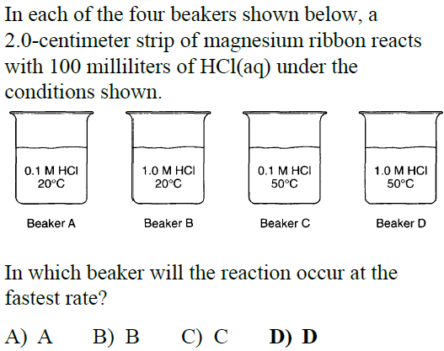
Answer 5

Slide 13
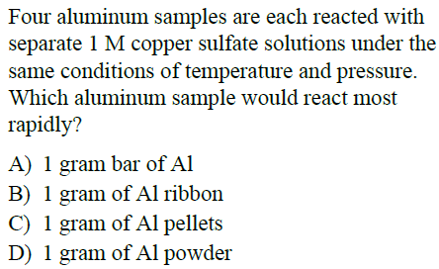
Question 6

Slide 14
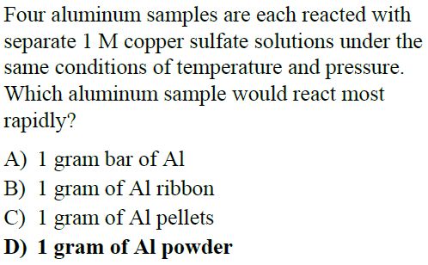
Answer 6

Slide 15
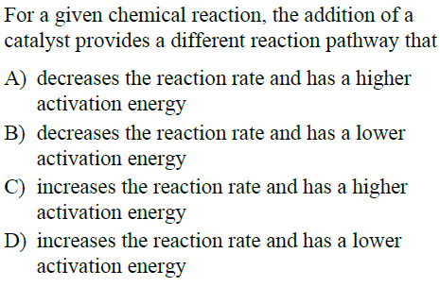
Question 7

Slide 16
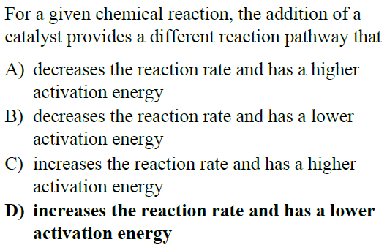
Answer 7

Slide 17
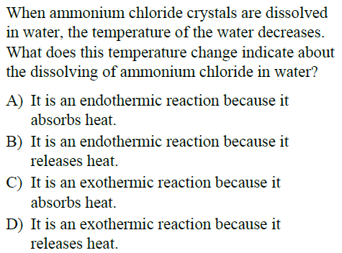
Question 8

Slide 18
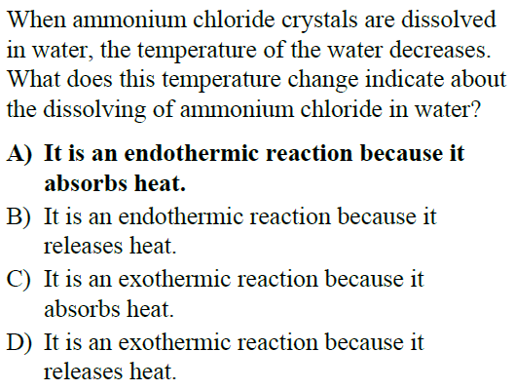
Answer 8

Slide 19
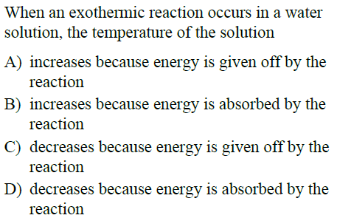
Question 9

Slide 20
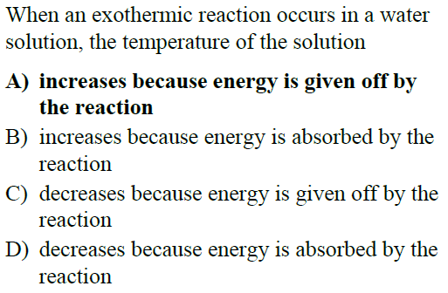
Answer 9

Slide 21
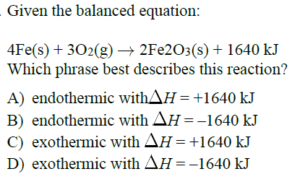
Question 10

Slide 22
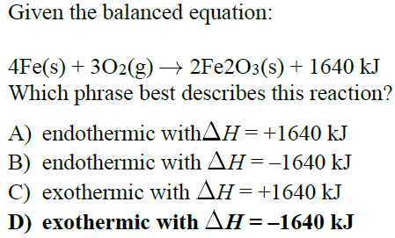
Answer 10

Slide 23
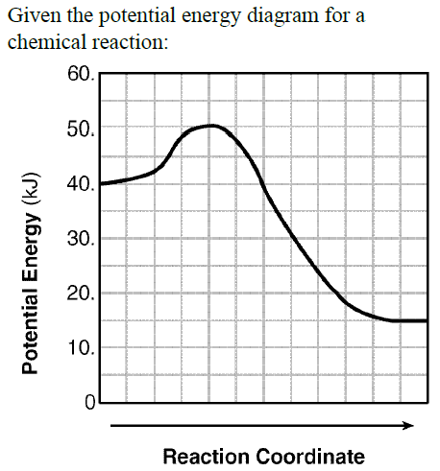
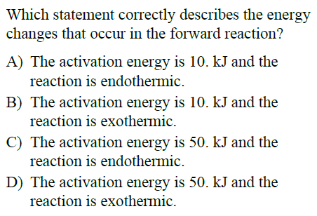
Question 11

Slide 24
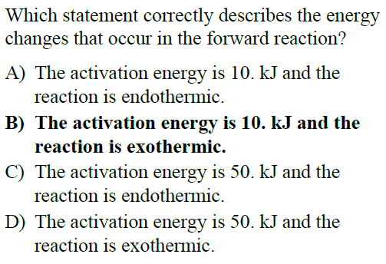
Answer 11

Slide 25
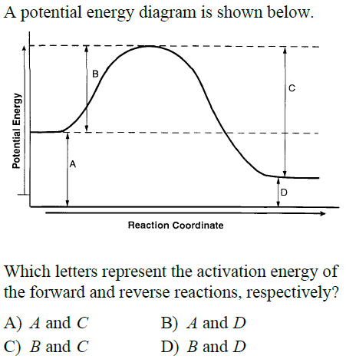
Question 12

Slide 26
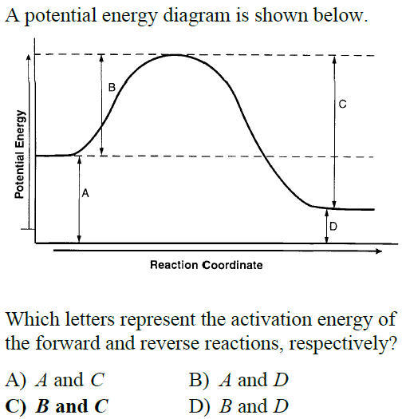
Answer 12

Slide 27
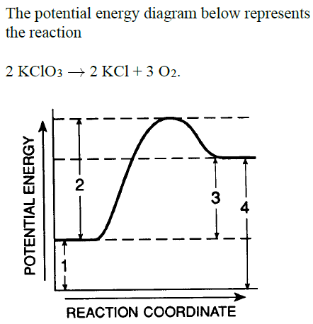
Question 13

Slide 28
Answer 13

Slide 29
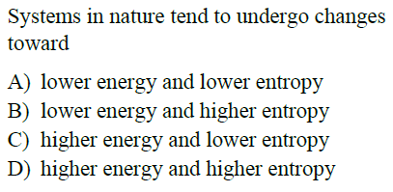
Question 14

Slide 30
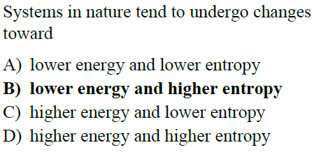
Answer 14

Slide 31
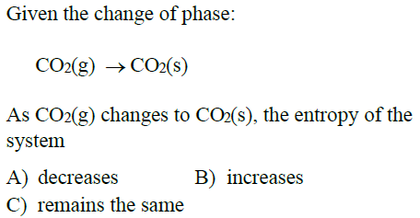
Question 15

Slide 32
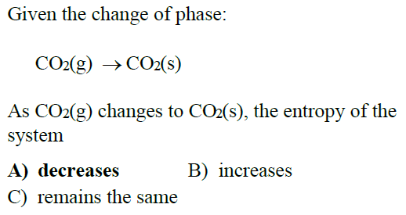
Answer 15

Slide 33
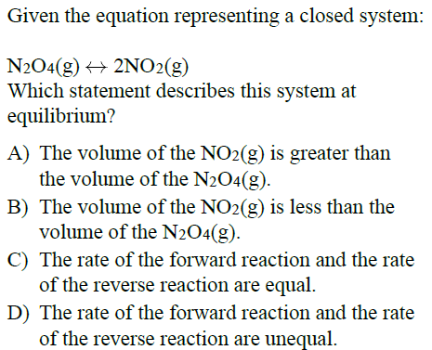
Question 16

Slide 34
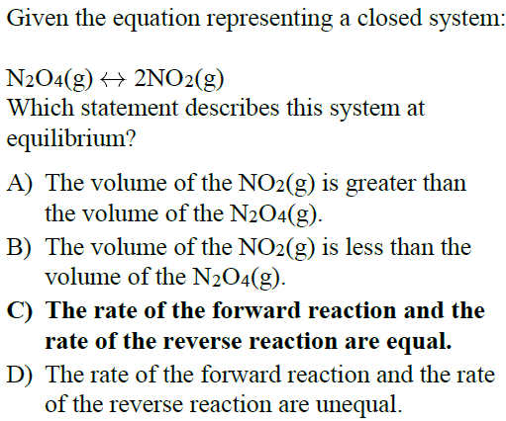
Answer 16

Slide 35
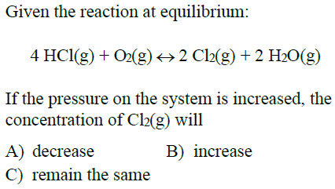
Question 17

Slide 36
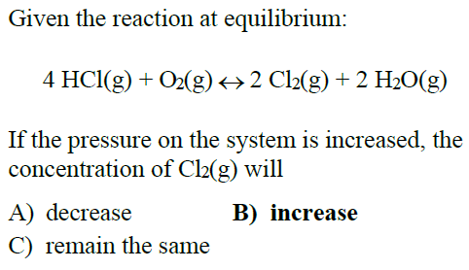
Answer 17

Slide 37
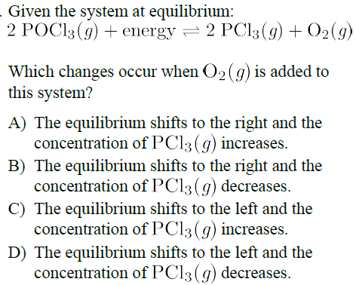
Question 18

Slide 38
Answer 18

Slide 39
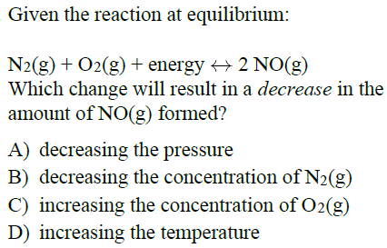
Question 19

Slide 40
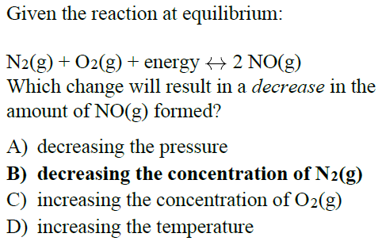
Answer 19

Slide 41
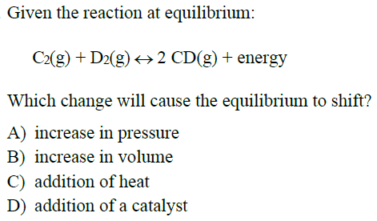
Question 20

Slide 42
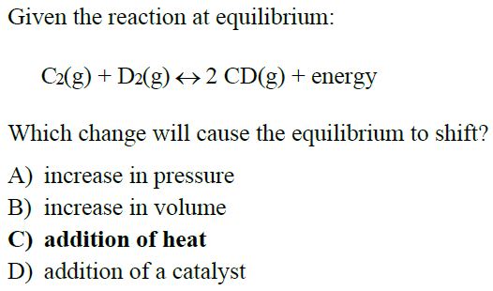
Answer 20

