Slide 1
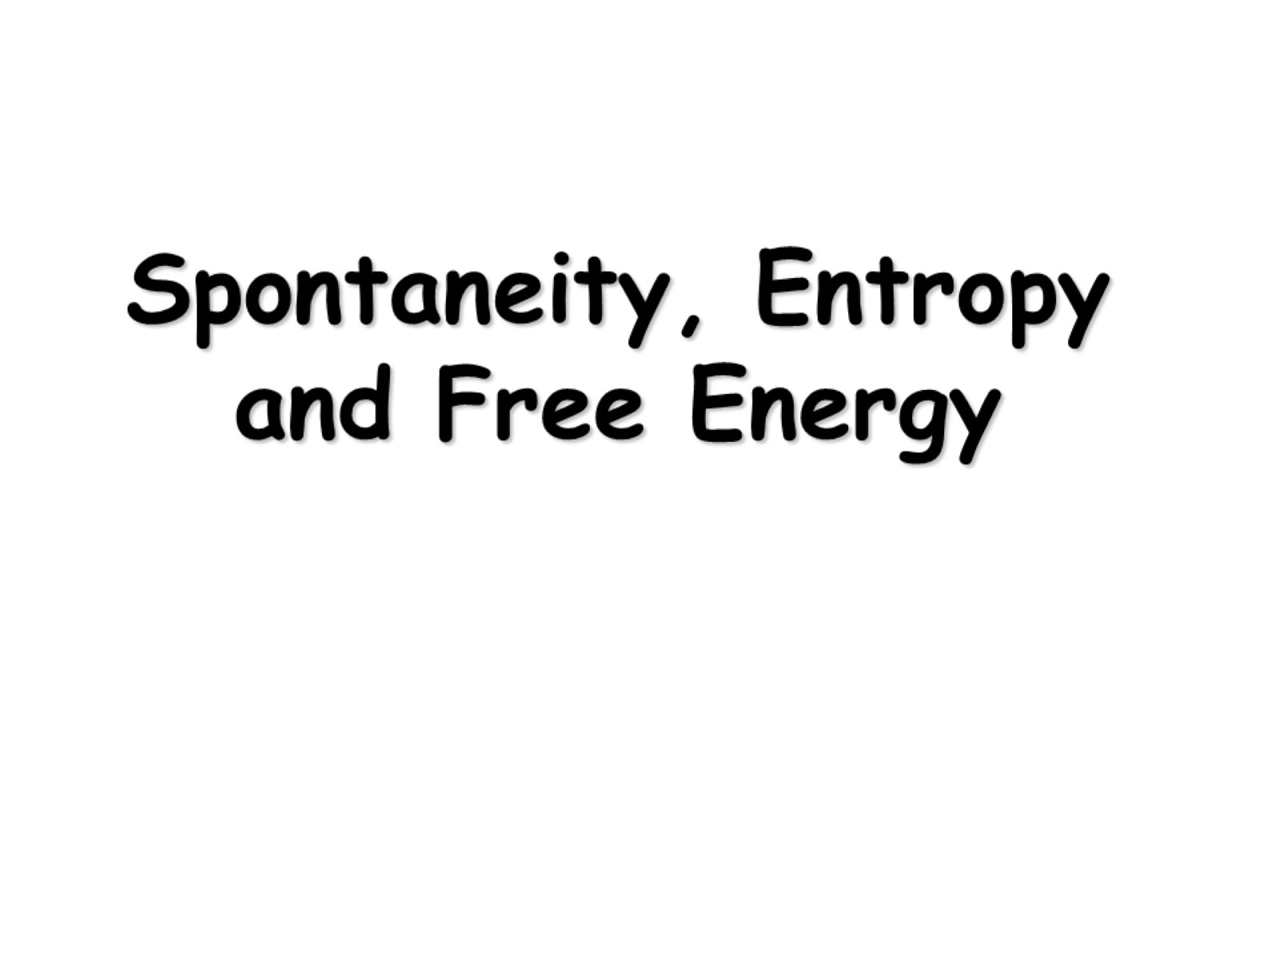
Spontaneity, Entropy and Free Energy

Slide 2
Spontaneous Processes and Entropy

Slide 3
Entropy (S)

Slide 4
Positional Entropy

Slide 5
Second Law of Thermodynamics

Slide 6
ΔH, ΔS, ΔG and Spontaneity

Slide 7
Calculating Entropy Change in a Reaction

Slide 8
Standard Free Energy Change

Slide 10
Calculating Free Energy: Method #2

Slide 11
Calculating Free Energy Method #3

Slide 12
The Dependence of Free Energy on Pressure

Slide 13
Free Energy and Equilibrium

Slide 14
Temperature Dependence of K

Slide 15
Free Energy and Work

