Slide 1
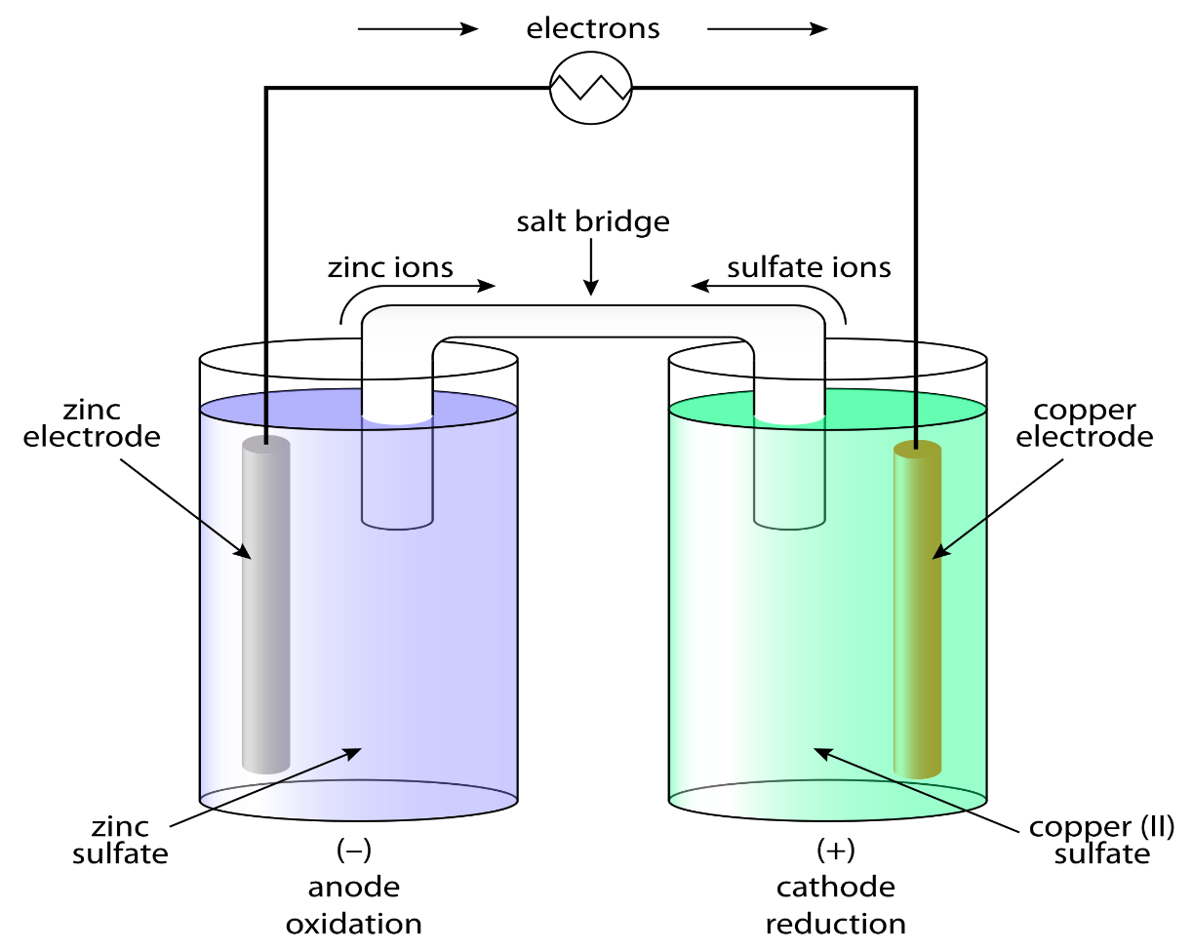
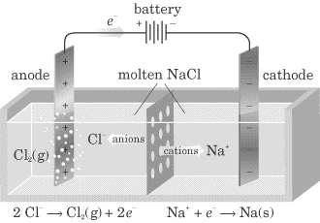
1. Introduction to Electrochemical Cells
Voltaic Cell
Electrolytic Cell

Slide 2
2. Voltaic Cells
Voltaic Cell - a redox reaction whose two half-reactions are carried out separately, and the electrons given off by the oxidation half-reaction are used to power a device, and then given to the reduction half-reaction. ALSO CALLED A BATTERY (9v) OR CELL (AAA, AA, C, D)
Voltaic Cell Animation and another set of animations: Complete Cell, Anode, Cathode, Salt Bridge
How a Voltaic Wet Cell Works:
Converts _____________ energy to ______________ energy by the use of a _______________________________
__________________ move from the metal that is ____________ to the metal that is _____________
Flow of electrons: ________________________________
CHEMICAL
ELECTRICAL
SPONTANEOUS REDOX REACTION
ELECTRONS
OXIDIZED
REDUCED
ANODE → CATHODE

Slide 3
2. Voltaic Cells
Parts of a Voltaic Wet Cell:
Electrode:
Anode:
Cathode:
REMEMBER:
A PIECE OF METAL WHERE OX. OR RED. OCCURS
ELECTRODE WHERE OXIDITION OCCURS (SIZE ↓ )
ELECTRODE WHERE REDUCTION OCCURS (SIZE ↑ )
“RED CAT and AN OX”
ANODE HAS
OXIDATION
REDUCTION OCCURS ON
CATHODE

Slide 4
2. Voltaic Cells
Salt Bridge:
External Circuit:
+ ions from bridge move into cathode half cell
- ions from bridge move into anode half cell
Ions from the salt brdige flow to the solutions completing the circuit
Keeps the overall charge neutral in the half cells
WIRE THAT CONDUCTS THE e⁻

Slide 5
3. Electrolytic Cells
Parts of an Electrolytic Cell:
Anode:
Cathode
Battery:
Electrolyte:
Flow of electrons:
Metal that is used to plate an object (+)
Metal that is being plated (--)
Produces energy to force nonspontaneous reaction to occur
Allow ions to flow between electrodes
e – start at anode and move toward the object being plated

Slide 6
3. Electrolytic Cells
Parts of a Electrolytic Cell:
Uses a ________________ redox reaction (the reaction _____________ occur on its own)
Uses ____________ to____________________
This process is called ________________________
Used for:
1)
2)
3)
nonspontaneous
will NOT
electricity
force a chemical reaction to occur
electrolysis
electroplating
Isolation of an element in a compound (NaCl→Na+Cl₂)
Purification of an element

Slide 7
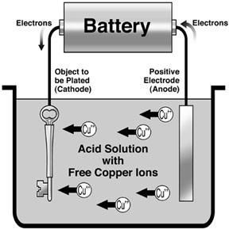
3. Electrolytic Cells
Electroplating (see electroplating video)

Slide 8
SUMMARY Similarities and Differences Between Voltaic and Electrolytic Cells
Similarities
“AN OX and RED CAT”
e – flow from anode to cathode
(+) ions flow toward the cathode, (--) ions flow toward the anode
Anode gets smaller, cathode gets larger

Slide 9
SUMMARY Differences Between Voltaic and Electrolytic Cells
Voltaic | Electrolytic
____________________________ | _____________________________
Anode is ____________________ Cathode is ___________________ | Anode is ___________________ Cathode is ____________________
____________________ electricity | __________________ electricity
_________________ REACTION | __________________ REACTION
½ Reactions are for… | ½ Reactions are for…
is an electric cell
requires a battery
negative
positive
positive
negative
PRODUCES
USES
SPONTANEOUS
NONSPONTANEOUS
Two different elements (two different solutions)
The same element (one solution both electrodes)

