Slide 1
STATION 1: CARBS, LIPIDS, PROTEINS

Slide 3
STATION 2: POLYMERS
Polymers Polymers consist of long chains and branches of molecules. Common polymers you encounter every day are organic molecules. Examples include nylon, acrylic, PVC, polycarbonate, cellulose, and polyethylene.

Slide 4
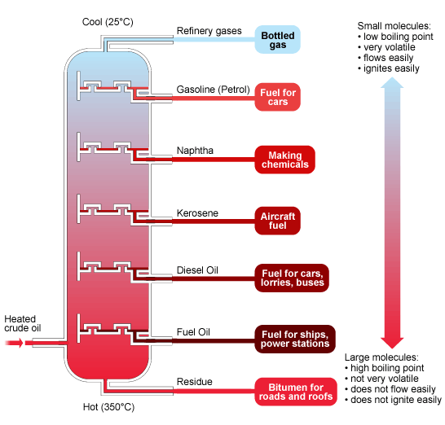
STATION 3: SOURCES OF ENERGY
Petrochemicals Petrochemicals are chemicals derived from crude oil or petroleum. Fractional distillation separates the raw material into organic compounds according to their different boiling points. You encounter products made from petrochemicals every day. Examples include gasoline, plastics, detergents, dyes, food additives, natural gas, and medicines.

Slide 5
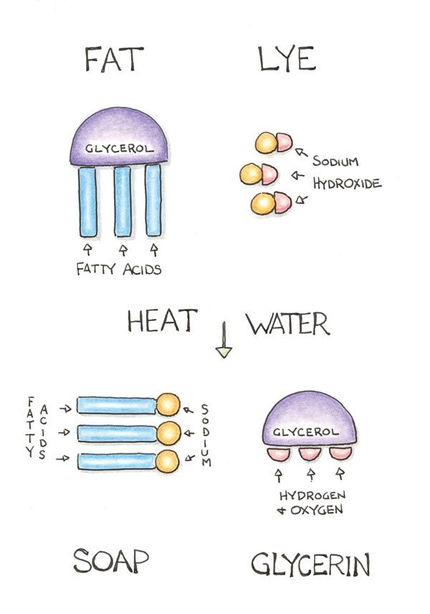
STATION 4: SOAPS AND DETERGENTS
Soaps and Detergents Although both are used for cleaning, soap and detergent are two different examples of organic chemistry. Soap is made by the saponification reaction (as shown to the right), which reacts a hydroxide with an organic molecule (e.g., an animal fat) to produce glycerol and crude soap. While soap is an emulsifier, detergents tackle oily, greasy (organic) soiling mainly because they are surfactants.

Slide 6
STATION 5: PERFUMES AND COSMETICS
Perfume Whether a fragrance comes from a flower or a lab, the molecules you smell and enjoy are an example of organic chemistry.
Cosmetics The cosmetic industry is a lucrative sector of organic chemistry. Chemists examine changes in the skin in response to metabolic and environmental factors, formulate products to address skin problems and enhance beauty, and analyze how cosmetics interact with the skin and other products.

