Slide 1

Unit 10:
Organic Chemistry
Topic 1: Introduction to Organic Chemistry
Objective: Review polar and nonpolar covalent bonds and molecules, identify properties of organic compounds and how they relate to covalent bonding and polarity of molecules, identify what the principle building block of organic compounds

Slide 2
I. Review of Polar and Nonpolar Covalent Bonds and Molecules
What is the difference between polar and nonpolar covalent bonds?
Polar Bonds: _____________________ (generally consist of: ______________)
Nonpolar Bonds: __________________ (generally consist of: _____________)
What is the difference between polar and nonpolar molecules?
Polar Molecules: _______________________________________________
Example:
2 different nonmetals
Unequal sharing of e⁻
2 of the same nonmetals
Equal sharing of e⁻
they are asymmetrical (e ⁻ UNEVENLY distributed in the molecule)
H₂O

Slide 3
I. Review of Polar and Nonpolar Covalent Bonds and Molecules
Nonpolar Molecules: _______________________________________________
Example:
they are symmetrical (e ⁻ EVENLY distributed in the molecule)
CH₄

Slide 4
II. Properties of Organic Compounds
Organic Chemistry: The study of ______________ containing compounds. They occur extensively in nature because all living things are made of _______________ containing compounds.
Review of Carbon
Has _______ unpaired valence electrons
Forms ________________________ bonds with other nonmetals
Forms _______________ (Two or more different structural forms giving it different properties)
Examples: ________________________________________________________
carbon
carbon
4
4 covalent
allotropes
Graphite, coal, diamond

Slide 5
II. Properties of Organic Compounds
Properties of Organic Compounds
1. Generally _______________ molecules (held together by London Dispersion/Van der Waals forces - which are ____________________ intermolecular forces (IMF))
______________________ melting and boiling points
Non-electrolytes – do not __________________________________
________________________ in water (because NONPOLAR molecules do NOT dissolve in POLAR solvents –REMEMBER “Likes dissolves likes)
______________________ – making them a primary source of energy
NONPOLAR
WEAK
LOW
CONDUCT ELECTRICITY
INSOLUBLE
COMBUSTIBLE

Slide 6
Unit 10:
Organic Chemistry
Topic 2: Naming and Writing Formulas for Organic Compounds
Objective: Identify hydrocarbons, difference between saturated vs. unsaturated hydrocarbons, isomers, write the molecular formulas and structural formulas for alkanes, alkenes, and alkynes,

Slide 7
III. Molecular Formulas of Hydrocarbons
Hydrocarbons: Organic compounds consisting of ONLY ___ & ___
C
H

Slide 8
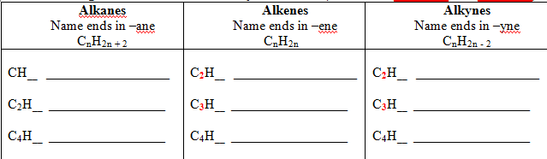
III. Molecular Formulas of Hydrocarbons
Naming Molecular Formulas of Hydrocarbons
(See Tables ____ and____)
P
Q
methane
ethene
ethyne
4
4
2
ethane
propene
propyne
6
6
4
butane
butene
butyne
10
8
6

Slide 9
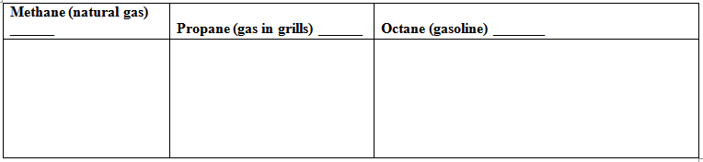
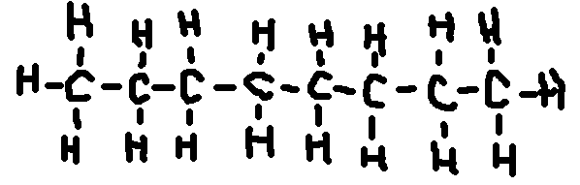
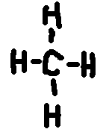
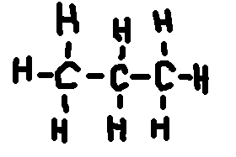
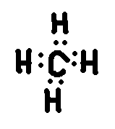
IV. Drawing and Naming Hydrocarbons
Structural Formulas of Alkanes
*NOTE: Structural formulas can be written without the hydrogens bonded to the carbon. You just have lines coming off the carbon to indicate that hydrogen is bonded to it.
CH₄
C₃H₈
C₈H₁₈

Slide 10
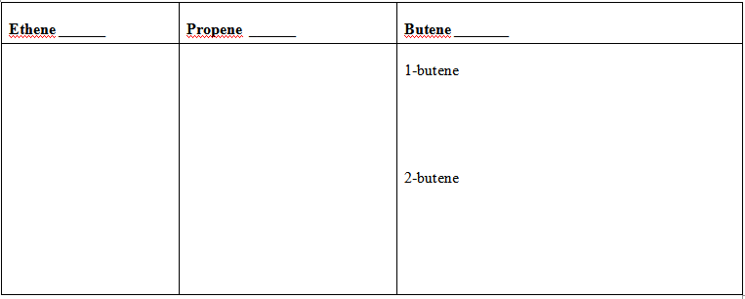
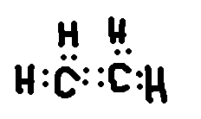
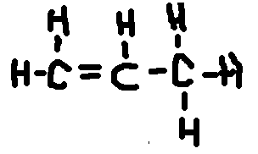
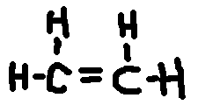
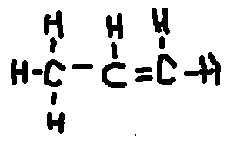
IV. Drawing and Naming Hydrocarbons
Structural Formulas of Alkenes
NOTE: If there is a double or triple bond, we want to know where it is in the chain of carbons, so we put a number to indicate which carbon the double or triple bond is on (USE THE LOWEST NUMBER POSSIBLE)
C₂H₄
C₃H₆
C₄H₈
OR
OR

Slide 11
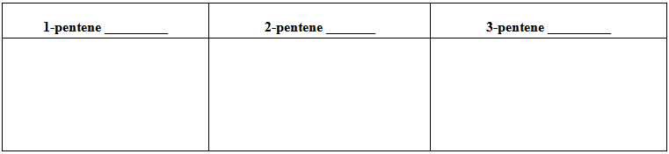
IV. Drawing and Naming Hydrocarbons
molecular
Isomers: Molecules with the same ____________________ formulas, but different
___________________ formulas.
To name an isomer of alkene:
      Look where the double bond is located
      Put a number to indicate which carbon the double or triple bond is on (USE THE LOWEST NUMBER POSSIBLE)
structural

Slide 12
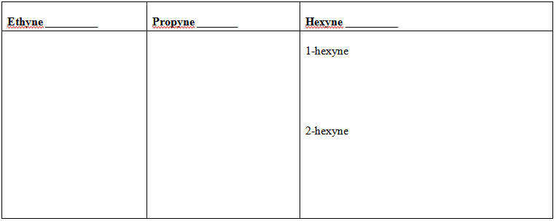
IV. Drawing and Naming Hydrocarbons
C. Structural Formulas of Alkynes
NOTE: Follow the same rules as naming alkenes
(use a number to indicate where the triple bond is)

Slide 13
V. Aromatic Hydrocarbons
Hydrocarbons that are ____________________ and exhibit ______________
Resonance: Double bonds that move through the molecule
Example: Benzene –
cyclic (ring of carbons)
resonance

Slide 14
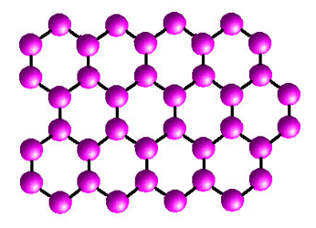
VI. Network Structures of Hydrocarbons
Carbon can make different network structures
(these are all allotropes of carbon)
Example:
Other Examples:
Graphite
nanotubes, diamonds, bucky balls

Slide 15
VII. Saturated vs. Unsaturated Hydrocarbons
Saturated Hydrocarbons: hydrocarbons with _________________
Family Name: ___________________
Example: Butane
ALL SINGLE BONDS
ALKANES

Slide 16
VII. Saturated vs. Unsaturated Hydrocarbons
Unsaturated Hydrocarbons: hydrocarbons with _______________
Family Name: ___________________
Example: 2-Butene
double or triple bond
Alkenes or Alkynes

Slide 17
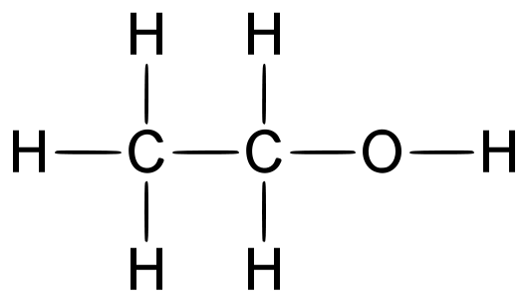
Unit 10:
Organic Chemistry
Topic 3: Branched (Substituted) Hydrocarbons
Objective: Draw structural formulas of branched hydrocarbons from their names, write the names of branched hydrocarbons from their structural formulas, identify isomers of branched hydrocarbons

Slide 18
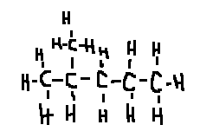
VIII. Molecular Formulas of Hydrocarbons
Hydrocarbons can have other atoms or groups of atoms added or substituted onto a hydrocarbon chain.
Alkyl Groups: ___________________ molecules with their a H removed, allowing it to have another hydrocarbon chain attached to it
Methyl Group: ____ hydrocarbon branch attached
Example: 2-methylpentane
ALKANE
1

Slide 19
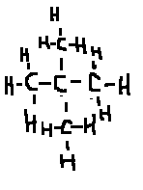
VIII. Molecular Formulas of Hydrocarbons
Example: 2, 2-dimethylpropane
Ethyl Group: ____ hydrocarbon branch attached
Example: 3-ethylhexane
2

Slide 20
The next groups are called Functional Groups (found on Table ____). The atom(s) or group of atoms are bonded to a chain of hydrocarbons to give it specific properties. We use the IUPAC (International Union for Pure and Applied Chemistry) naming system to identify/name organic compounds.
R
halogen (F, Cl, I, Br)
B) Halide Groups: a _____________________atom or atoms that are on the chain in place of a hydrogen. See Table _____
R
1-chloroethane | 2-bromobutane
2,3-dichlorobutane | 1 chloro 2,3-dibromo pentane

Slide 21
C) Hydroxyl Groups (Alcohol): a _____attached to the end carbon (primary,1st), a middle carbon (secondary, 2nd), or tertiary carbon (3rd).See Table _____
Properties:
1. Small alcohols are ____________and will ______________
2. Naming – Position of OH- (prefix for # of C)-anol
-OH
R
DISSOLVE IN WATER
POLAR
Methanol (wood alcohol) | Ethanol (grain alcohol) | 1,2 ethandiol (antifreeze)

Slide 22


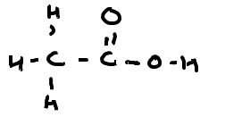
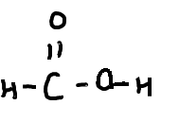
D) Organic Acids: General Formula ____________________
- Acid strength increases as number of carbons ____________
- Naming – (prefix for # of C)-anoic acid
R-COOH
DECREASES
Methanoic acid (formic acid) | Ethanoic acid (vinegar)

Slide 23


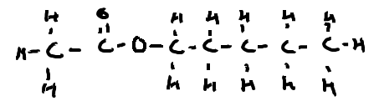
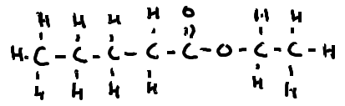
E) Esters: General Formula ____________________
- Used to make ______________________________________
- Naming – __(R2 prefix)__yl ___ (R1 + C prefix) ___ anoate
R₁-COO-R₂
ARTIFICIAL FLAVORS AND ODORS
Ethyl pentanoate (apple) | Pentyl ethanoate (banana)

Slide 24


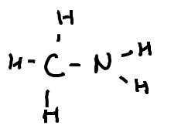
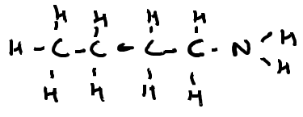
F) Amines: General Formula ____________________
-NH₂ is always on the 1st carbon
Used in dyes and medications
Naming - __(prefix for number of carbons)__ anamine
R-NH₂ (may be on the 1st 2nd, or 3rd )
(FOR THIS COURSE)
Methanamine | Butanamine

Slide 25


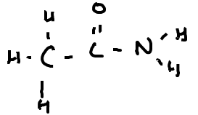
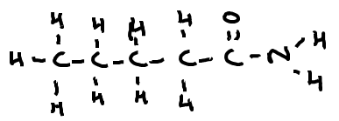
G) Amides: General Formula ____________________
- CONH₂ is always on the 1st carbon
- Used in rubber and plastic manufacturing
- Naming - __(prefix for number of carbons)__ anamide
R-CONH₂
(FOR THIS COURSE)
Ethanamide | Pentanamide

Slide 26


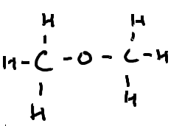
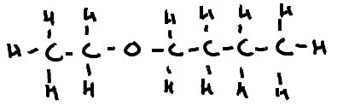
H) Ethers: General Formula ____________________
- A single oxygen atom between two alkyl groups
- Used in anesthetics
- Naming - __(prefix for #C in R1)yl (prefix for #C in R2)yl ether
R₁-O-R₂
Dimethyl ether (methyl methyl ether) | Ethyl butyl ether

Slide 27


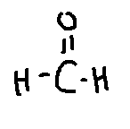
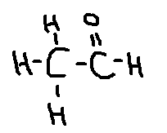
I) Aldehyde: General Formula ____________________
-CHO is on the first carbon
- Used in preservatives
- Naming - __(prefix for #C)-anal
R-CHO
Methanal | Ethanal

Slide 28


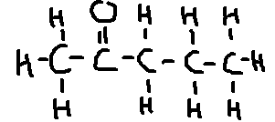
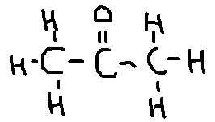
R₁-CO-R₂
J) Ketones: General Formula ____________________
- Used to make Nonpolar solvents
- Naming – (CO position) – (#C prefix)-anone
2-propanone (acetone-nail polish remover) | 2-butanone

Slide 29

Unit 10:
Organic Chemistry
Topic 4: Organic Reactions
Objective: Determine what kind of reaction is required to make the desired organic product, complete simple organic reactions, and identify the reaction that is proceeding based on structural formulas or molecular formulas

Slide 30
VI. Seven Types of Organic Reactions
In general, these are slower than inorganic reactions because bonds need to be broken
Frequently involve only the functional groups of the molecule, the majority of the molecule remains unchanged
Substitution Reactions:
Involve ___________________ hydrocarbons (___________________)
One of the _____________________ are removed (usually on the end)
It is replaced with an atom of ___________________. HA is the by-product
SATURATED
ALKANES
HYDROGENS
HALOGEN

Slide 31
VI. Seven Types of Organic Reactions
Substitution Reactions:
Example: CH₄ + Cl₂ →
Example: CH₃CH₃ + Br₂ →

Slide 32
VI. Seven Types of Organic Reactions
      2. Addition Reactions:
Involve ________________ hydrocarbons (__________________)
________________ bond is broke to form a __________________
ALKENES/
ALKYNES
UNSATURATED
DOUBLE/TRIPLE
HALOCARBON

Slide 33
VI. Seven Types of Organic Reactions
2. Addition Reactions:
Example: CH₃CH₂CHCH₂ + Br₂ →
Example: CH₂CH₂ + I₂ →

Slide 34
VI. Seven Types of Organic Reactions
      3. Combustion (Burning):
General Equation: Organic compound + O₂ → ____+ ____ + _____
Example: ____ CH₄ + ____ O₂ →
Incomplete Combustion: occurs when there is ____________________
present, therefore, the products that are made contain ____________________
Products are _______ and ________ or _____ and _______
Examples: 1) C₆H₁₄ + O₂ →
2) C₄H₁₀ + O₂ →
CO₂
H₂O
HEAT
1
2
2
___ CO₂ + ___ H₂O
1
not enough O₂
less O₂
CO
H₂O
C
H₂O
CO + H₂O
C + H₂O

Slide 35
VI. Seven Types of Organic Reactions
      4. Fermentation (making ethanol):
___________________ anaerobically digested by yeast or enzyme
Products are _______________________
When the concentration of ethanol reaches 14%, the yeast dies in its own waste products (ethanol and CO2)
Examples: 1) C₁₁H₂₂O₁₁ →
2) C₆H₁₂O₆ →
SUGAR (C_{n}H_{2n}O_{n})
ETHANOL and CO₂
ETHANOL and CO₂
CH₃CH₂OH and CO_{2 (NOT BALANCED)}
CH₃CH₂OH and CO_{2 (NOT BALANCED)}

Slide 36
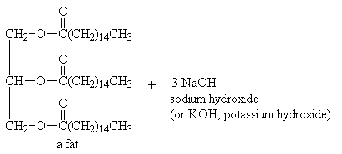
VI. Seven Types of Organic Reactions
      5. Saponification (making soap):
Occurs when a ___________________ is broken apart by a ______________
Products are _______________________
FAT (ESTER)
STRONG BASE
GLYCEROL and SOAP

Slide 37
VI. Seven Types of Organic Reactions
      6. Esterification (making esters):
Occur when an ________________ reacts with an _____________
Occurs by ____________________________________________
Products are ____________ and _______________
Example: Methanoic acid + ethanol →
ORGANIC ACID
ALCOHOL
DEHYDRATION SYNTHESIS (WATER REMOVED)
ESTER
H₂O
Water + ethyl methanoate

Slide 38
VI. Seven Types of Organic Reactions
      7. Polymerization (making polymers):
Intro
Polymer: ______________________________________________
Monomer:___________________________________________
Synthetic Examples: _____________________________________
Natural Examples: _______________________________________
ANY ORGANIC SUBSTANCE with REPEATING UNITS
BASIC ORGANIC UNIT OF ANY POLYMER
RUBBER and PLASTICS
PROTEINS, STARCH, and DNA

Slide 39
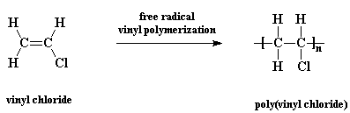
VI. Seven Types of Organic Reactions
      A. Addition Polymerization
Occurs with a _________________________________ hydrocarbon
The double or triple bond is… _____________________________
________________________________________________________
The product is a ______________________
Example: vinyl chloride → polyvinyl chloride
UNSATURATED (DOUBLE/TRIPLE BONDED)
BROKEN AND USED TO BOND
THE MONOMERS TOGETHER IN A LONG CHAIN
POLYMER

Slide 40
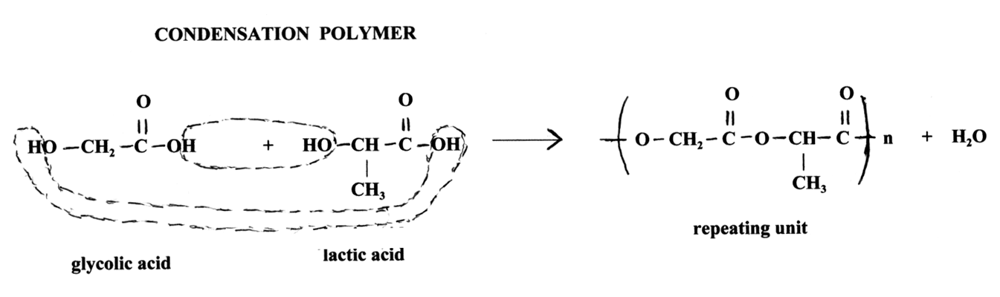
VI. Seven Types of Organic Reactions
      B. Condensation Polymerization
Occurs by ______________________________________ and always produces ______________________________
Example:
DEHYDRATION SYNTHESIS
WATER with a POLYMER

